Slide 1
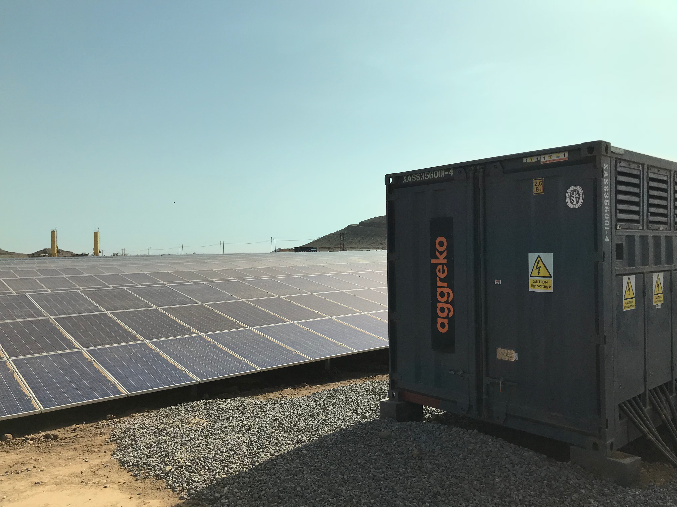
Flexible long-term energy solutions
Aggreko microgrids and energy storage

Slide 2
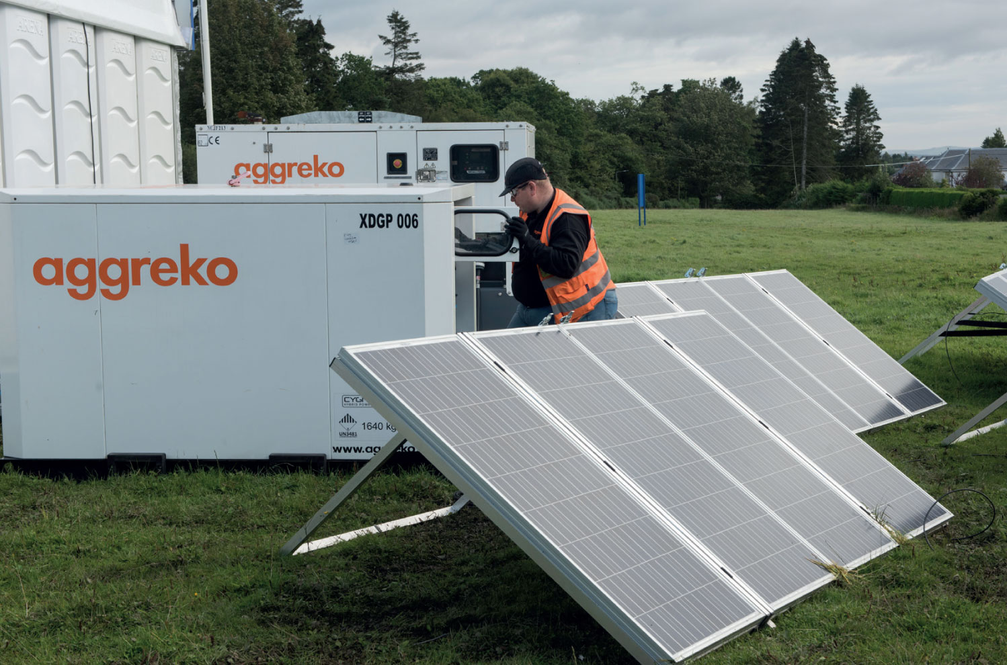
LONG-TERM POWER
Aggreko - your power partner for the long-term.
At Aggreko, we help you progress your business with better – and cleaner – energy solutions for the life of your project.
Guiding
customers
to net-zero
We are constantly adapting to make sure our focus on a sustainable future is at the forefront of our strategy.
We are committed to ensuring that our success also brings long-term social and economic benefits to the communities and countries where we operate.
We’d be delighted to speak to you about your future energy needs.
Contact us on 1800 808 109.
At Aggreko, we want to help our customers fully realise the potential it brings to the future of energy and the new landscape it’s forging.
With the choices available to achieve reliable sustainable power projects increasing and changing rapidly, you’ll want to take advantage of smarter ones that maximise the different technologies and fuels available – and that’s exactly what Aggreko can offer.
We will work alongside you to provide a tailored solution, no matter what stage of the Energy Transition you are at – driven by our commitment to create better energy solutions together.
As power specialists for the mining, utilities, and oil and gas sectors, we understand the energy you need to operate effectively – regardless of your site’s location or how complex your operation’s needs are.
We also understand the practical challenges of reducing your carbon emissions. That is why we will work with you and use our deep expertise to develop the right choice of solutions and services to give you the energy you require.
Our Flexible BOOM (Build-Own-Operate-Maintain) Service Model assists our power plant customers to use their capital more effectively within their own business.
Under this contract model, we tailor your power plant to suit your site’s size, environment and compliance requirements.
As a major investor in your project we also continue to operate and maintain the plant, so it continues to work cost-effectively and efficiently. We also take care of the site’s evolving power needs, including technological upgrades.
Partnering with Aggreko helps customers de-risk the threat of future innovation and frees up your working capital for profitable uses without increasing the project’s debt ratio.
Our modular, scalable equipment also gives businesses the ability to leverage innovation at low risk and not be concerned about having the latest equipment.
Through our BOOM partnerships Aggreko and our customers have the added mutual benefit of showcasing and utilising new innovations through out a project’s lifecycle.
We can easily and efficiently scale our power plants up or down depending on an operations’ requirements.
This means we can adapt quickly to provide more when you’re busy or less if things slow down.
We concentrate on providing efficient, flexible energy for your project for as long as you need us, allowing you to concentrate on your core business
Because we are the only global provider of flexible energy solutions and services, you’ll receive
the same high standards from us regardless of where your mine or project is located
around the world.

Slide 3
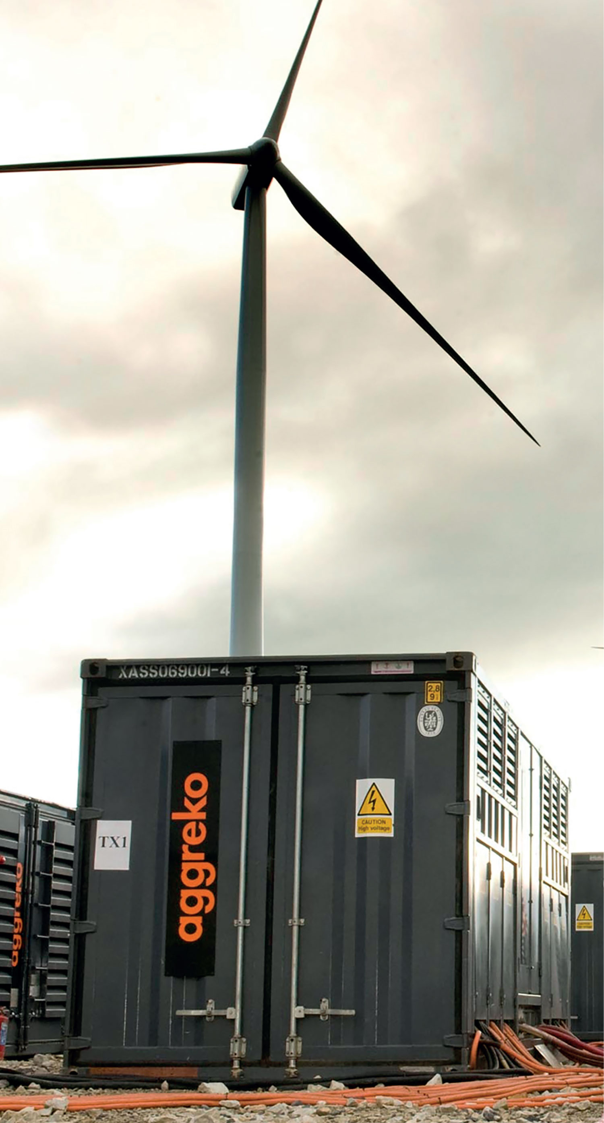
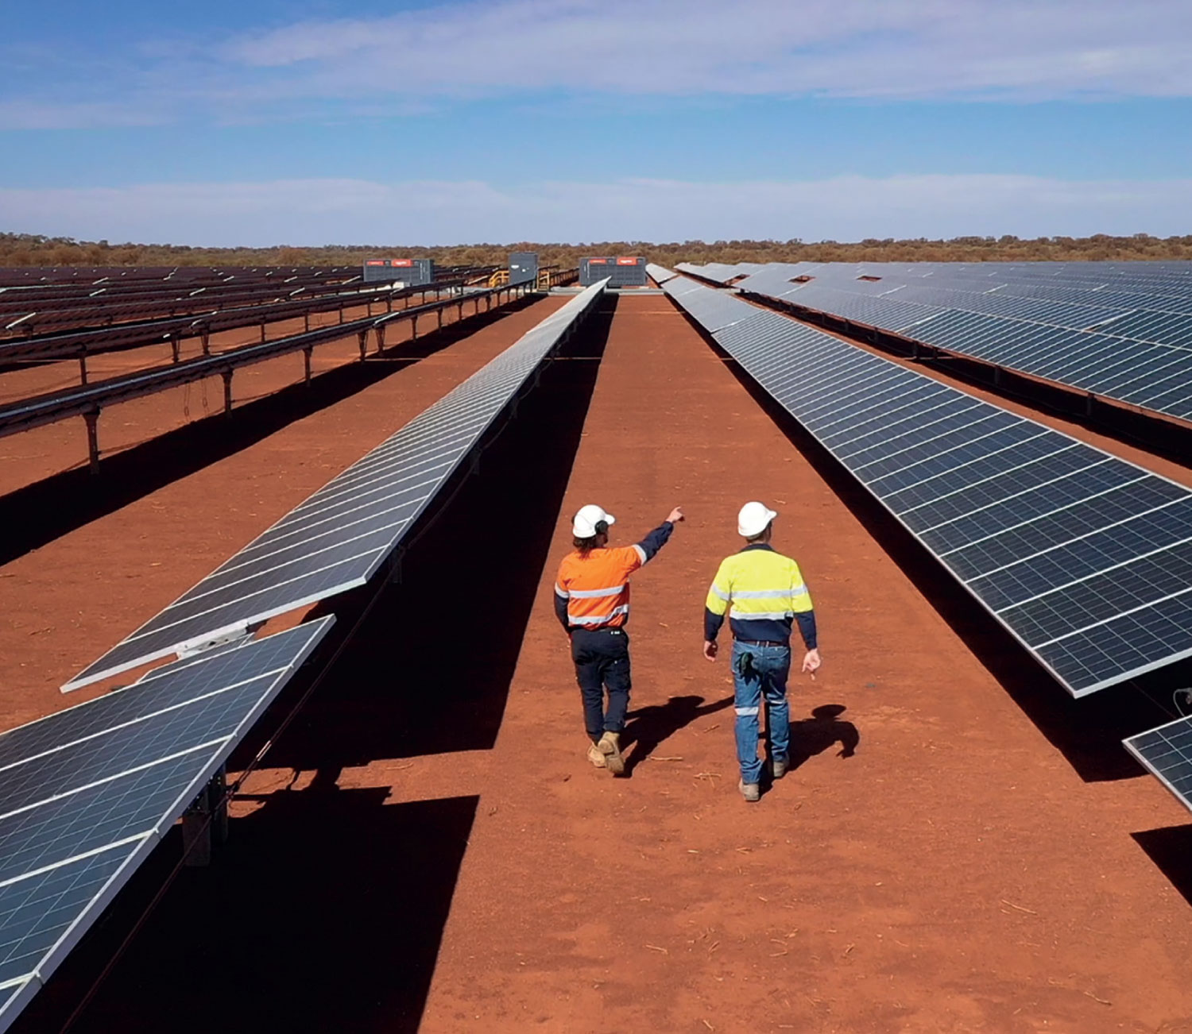
LONG-TERM POWER
Our reach
Aggreko is the global leader for temporary mobile modular power, temperature control
and energy services with 204 locations world-wide, across more than 80 countries.
Our company was founded in 1962 and has continually been at the forefront of innovation and the latest technology for energy services.
We work with a clear commitment to safety, diversity and inclusion, health and well-being and human rights wherever we go.
Our solutions
Acquiring an uninterruptible
power source is a challenge
for mines or remote projects,
however Aggreko’s solutions
are superior, providing safe and
stable energy particularly in
areas where there is limited or
no access to mains power or gas.
Solutions are also supported by our company’s 24/7 remote monitoring, and maintenance is performed as and when needed. Additionally, we can draw on a global team of experienced engineers to creatively solve unique challenges staff face in remote locations.
Our batteries and generators are modular, moveable and can be scaled up or down to meet demand. Best of all, as we upgrade our technology, we upgrade yours too.
We have more than
6,000
staff world-wide, with
staff readily able to
assist when needed.

Slide 4
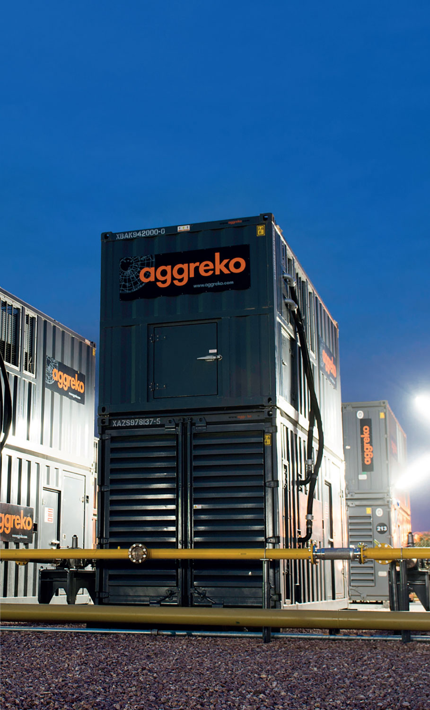
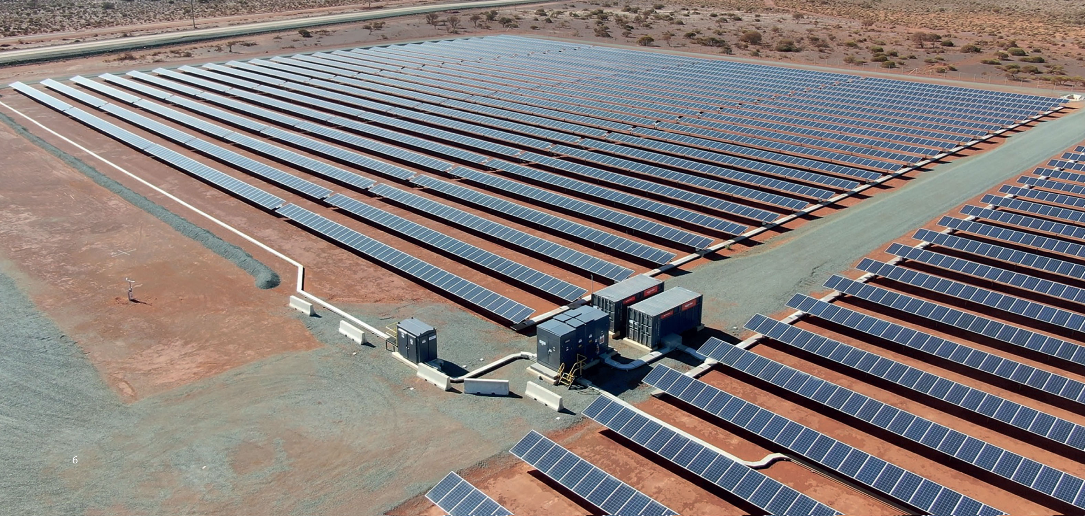
LONG-TERM POWER
Hybrid power plants
Benefits of hybrid systems
Introduce renewable power as viable
Low cost of energy
No fuel costs
Low O&M costs
Flexible service life
Reduced emissions
Supporting ESG targets
We start by working with you to find
the best location for your power plant.
We consider environmental and local
regulations and create detailed plans,
including 3D modelling of the proposed
site. We can take care of civil works,
if needed – which include levelling
the ground, building roads, putting
in drainage and laying fuel lines. We:
Supply generators, transformers and switch gear
Provide fuel management systems, fuel tanks, monitor fuel levels and schedule deliveries
Supply control rooms, operated 24/7 by our experienced plant technicians
Supply high-voltage and low-voltage power cables
Provide safety management practices
to keep workers safe
When it comes to power, one way the
mining, oil and gas, and utilities sectors can improve efficiency and bottom lines massively is through the implementation of hybrid power.
As operations continue to decentralise
from the power grid, finding innovative
ways to keep costs and emissions in
check is an ongoing challenge.
Hybrid power plants combine the
advantages of renewable energy
(such as wind, hydro power, solar)
and battery storage with the reliability
of thermal generators.
Our battery storage system gives you greater power quality and resilience.
It also delivers savings to your project,
by improving the overall plant efficiency
and thereby reducing fuel consumption
and carbon emissions. Our hybrid solution
will provide your site with the dependable
energy your productivity hinges on –
while your costs and carbon footprint
will shrink in the process.
It’s fast to deliver and set up – and it’s
all bundled into a single contract. The innovative plants deliver efficient,
reliable power that result in a significant
reduction of greenhouse gas emissions
Installation, maintenance and decommissioning
As supply needs change, we can scale up
or down on both installed capacity and
fuel contracts.
Being the one power supplier, we provide
the in-house engineering and technical
support, which reduces administration
and provides higher service levels, quicker
responses, and problem resolution.
We can train local people to run the
temporary or long-term power station
until it is not needed anymore, and then
proceed to decommission the equipment
and remove it from your site.
Our robust design practises ensure that
the power plant will deliver power reliably.
Any size power source from 20 kVa to
250MW is available as and when needed.
This scalable solution matches capacity
with the demand to ensure the plant runs
at maximum efficiency giving you maximum return on the investment.
We can supply diesel or gas generators,
renewables, or a combination of all, to power
the plant and equipment and we can adapt
the fuel type at minimal cost giving you the
lowest cost fuel option.

Slide 5
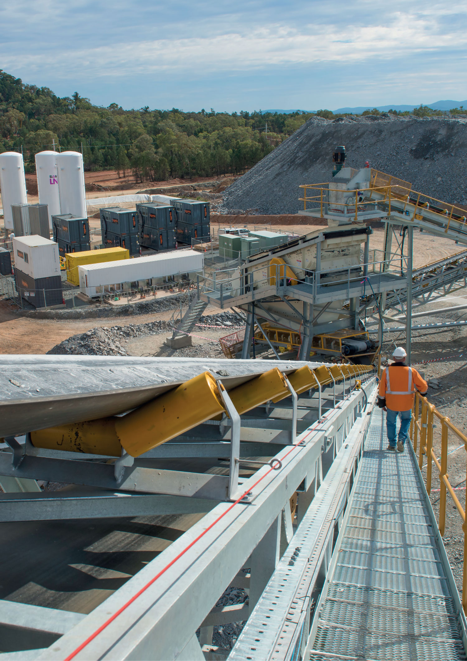
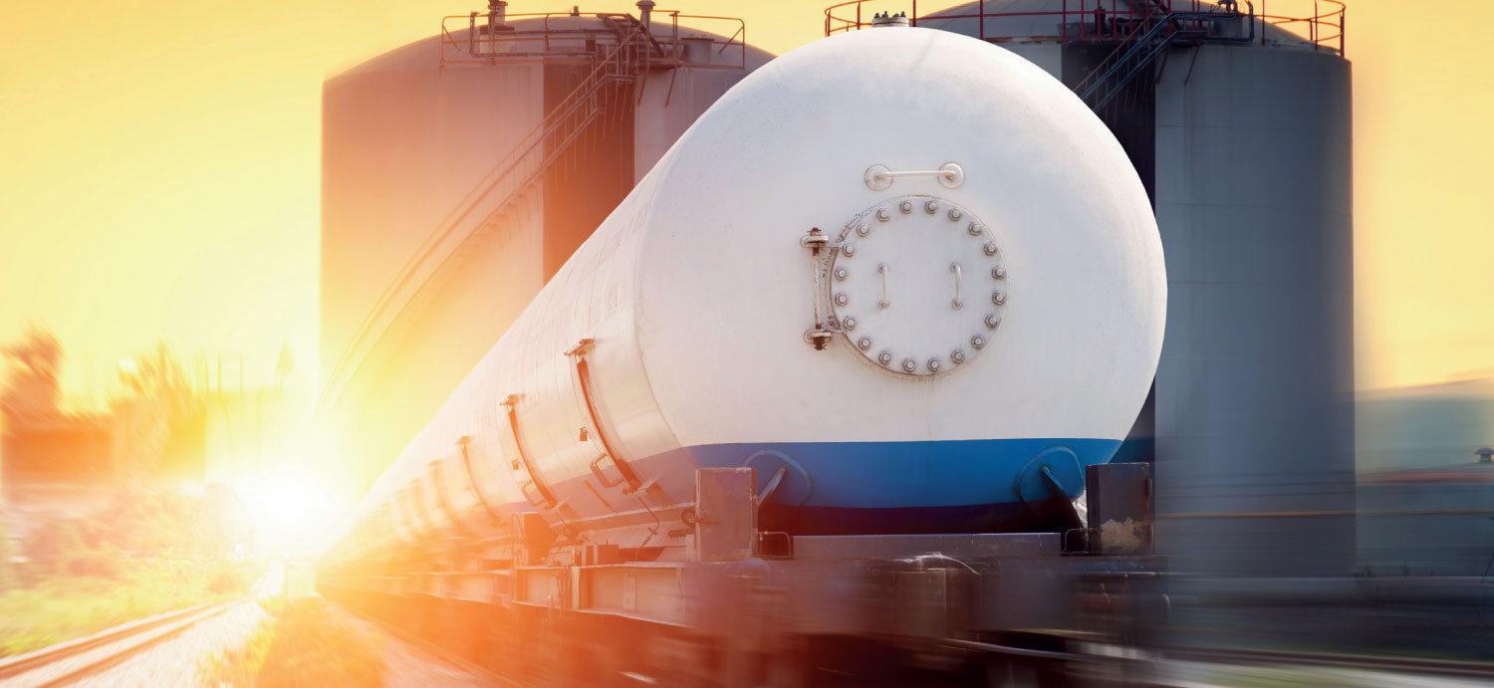
LONG-TERM POWER
Virtual gas
power plants
No gas pipelines
Where no gas pipeline or grid
connection exists, the LNG or CNG
virtual pipeline enables natural gas
to be used as primary fuel for power
generation using our modular
generators. In addition, an LNG
or CNG virtual pipeline can provide
back-up fuel where natural gas
pipeline capacity is limited.
For sites that aren’t connected to
a physical pipeline and looking to
switch to gas from diesel, the virtual
pipeline model simply imitates their
current supply solution. Diesel, the
virtual pipeline model simply imitates
their current supply solution.
For users connected to a gas pipe
line but are looking to supplement
insufficient or unreliable pipeline
capacity, the virtual power plant
solution has several advantages over
diesel as the system is simply using
stored natural gas to augment pipeline
natural gas and can use the same
delivery system.
Gas power generation offers a greener
and more cost-effective alternative to
diesel and HFO, however, not every site has an existing gas pipeline they can leverage. Even where a gas pipeline exists, insufficient supply during peak
periods may be an issue hampering your mine production.
Our virtual gas power plants are the seamless solution that delivers power to you when such challenges arise.
A virtual pipeline is a substitute for a physical pipeline where gas
that would typically
be conveyed through a conventional gas pipeline is instead transported
as LNG to the point of
use by sea, road, or rail.

Slide 6
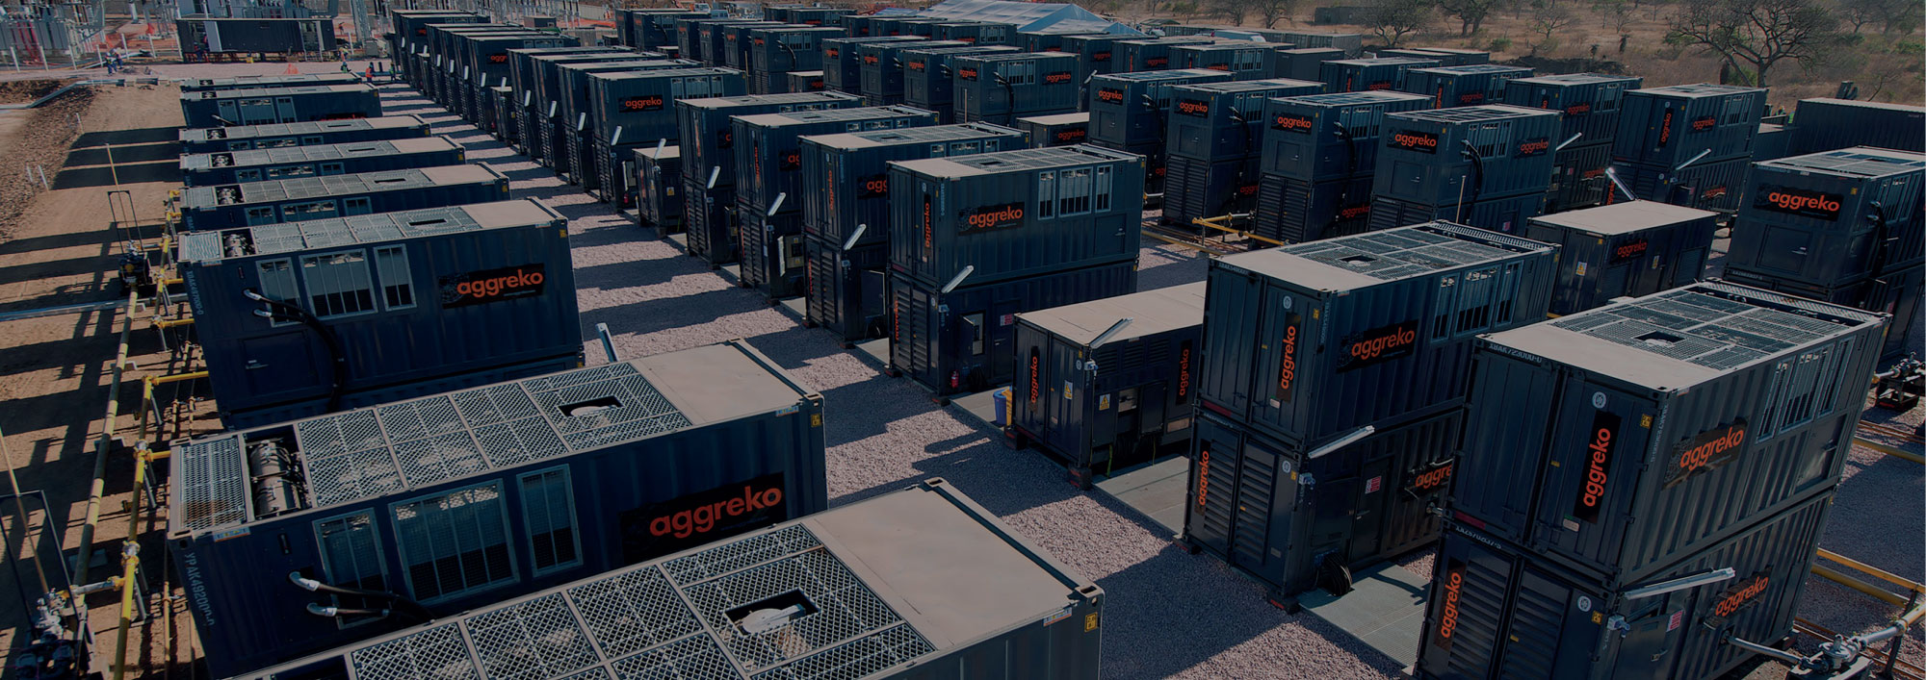
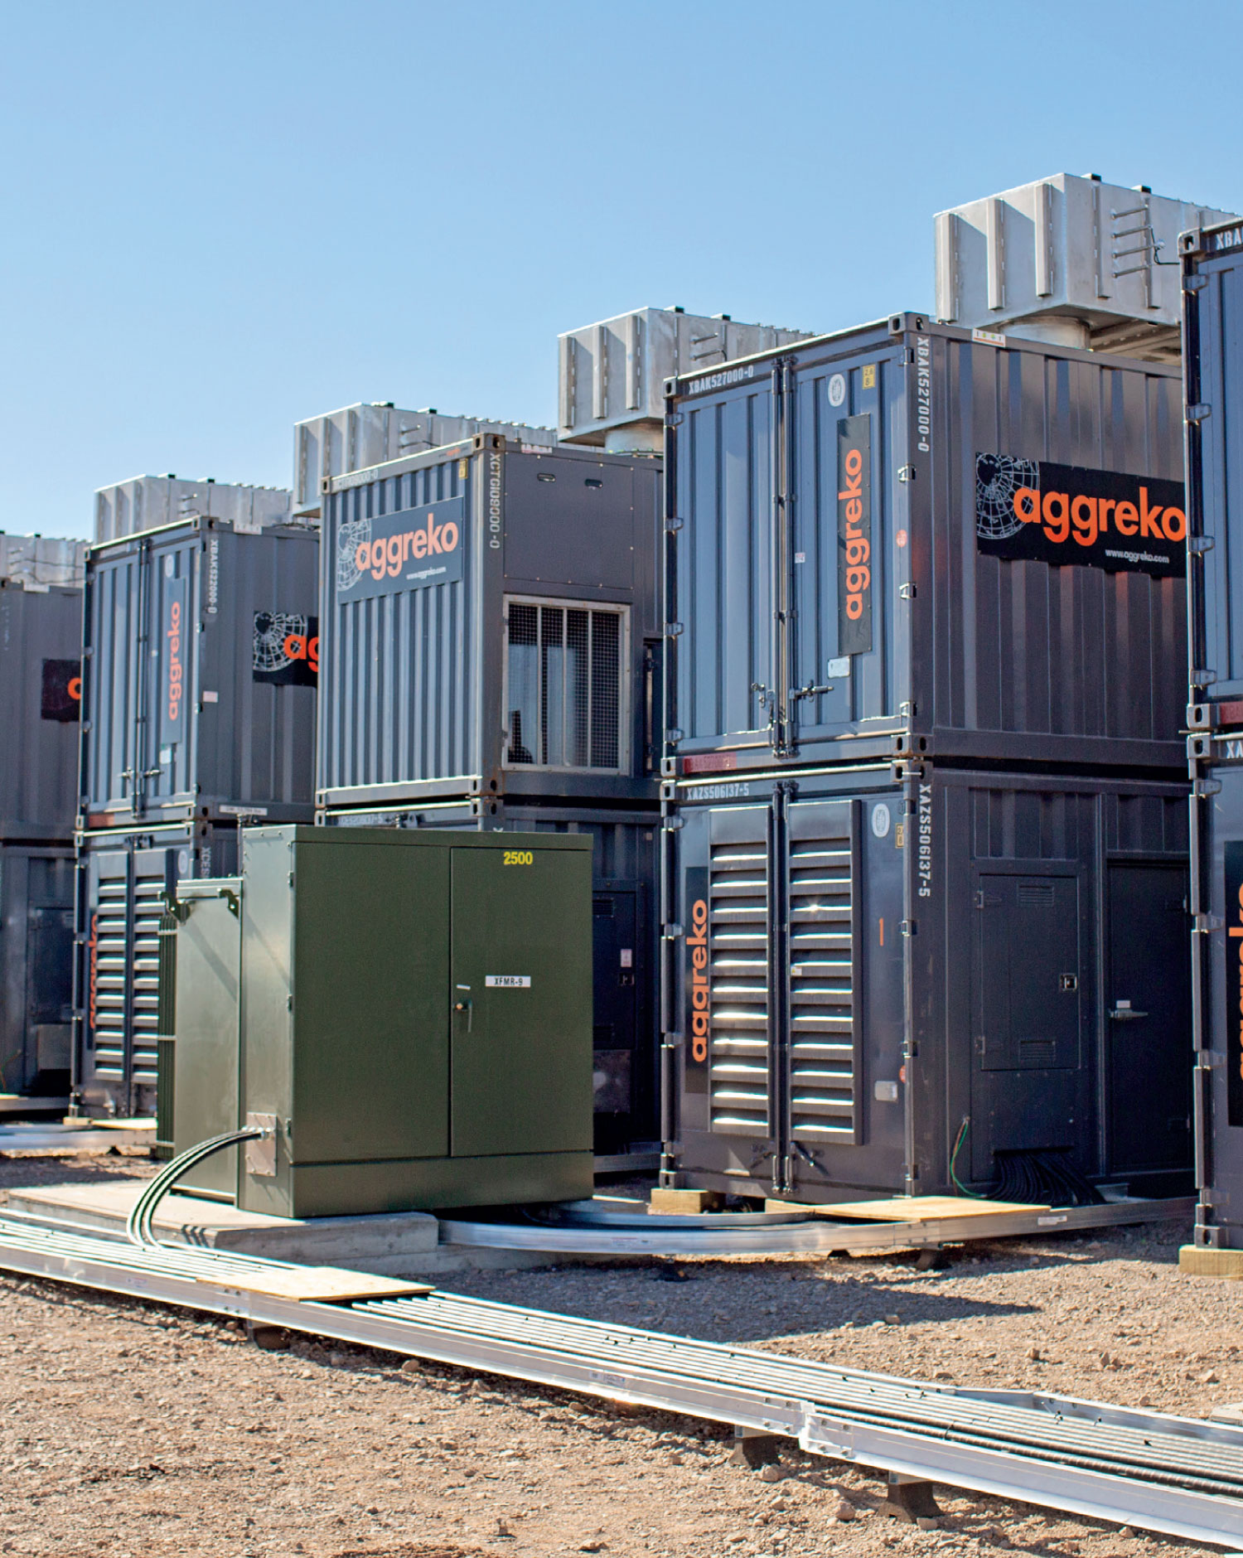
LONG-TERM POWER
Take a closer look at our products
Generators
(High efficiency
diesel and gas)
Our generators are built in ISO
standard containers, which
means they can be transported
using standard methods – that
saves time and money.
And because we have designed
them in a range of capacities
we can scale our power to your
unique needs, so you get what
you need, how and when you
need it, and if those needs
change, then we can scale our
provision up or down to suit.
Our generators run on gas,
diesel or biofuel, as well as
hybrid resources, according
to what you need.
They are sound-attenuated,
available in 50 or 60 Hz and
come with containment bases
that prevent fuel spillage.
We also provide flexible
fuel storage tanks with
environmentally responsible
double-wall construction.
All equipment is fully tested
to ISO standards and safety
measures are built-in to lessen
environmental impact.
We have the world’s
largest
fleet of mobile, modular
power generation with
about 10 GW in our fleet

Slide 7
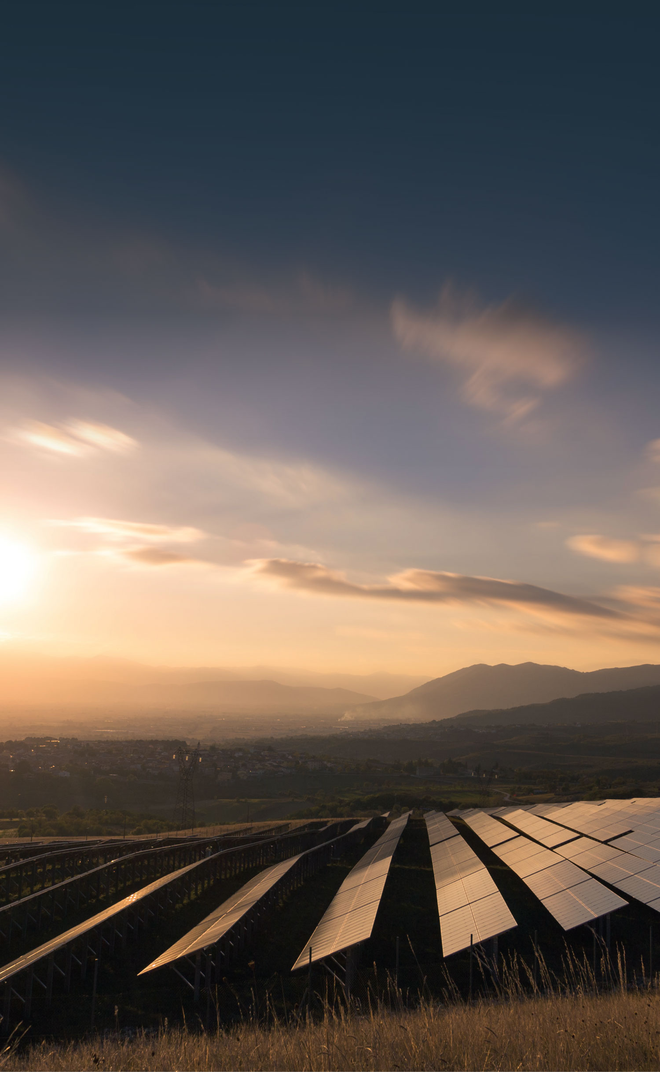
LONG-TERM POWER
Aggreko
solar power
Lower costs of energy and zero
emissions – our solar power is the
ideal solution for customers who
want to benefit from clean energy
innovation without the need for
long-term financial or
technological investment.
Our flexible solution is ideal for areas
with weak or no grid connection and
can be deployed in as little as three
months. It boosts the reliability of
your power supply and reduces the
need to transport fuel over
long distances.
Our flexible solar
power solutions
Aggreko offers fixed or self-contained
and quickly deployable units, with
our solutions tailored to specific sites
and regions, considering the climate,
location, life of the project, and whether solar panels need to move around the site.
We help establish a customers’ needs
first by performing a remote site
assessment, followed by a site-visit
assessment to determine the best
solutions for the project.
No capital outlay
No risk
The sun’s power
is endless. Our PV contracts end when you want
With the world changing rapidly, the last thing you want is being unable to act when a change affects you – because you’re tied into a long-term contract. Our solar power contracts begin at just five years and there’s no upfront investment involved.
By outsourcing your power with Aggreko, you can focus on utilising your working capital and maximising the returns from your current operations and assets while transitioning to a lower-carbon future.
Our solution integrates seamlessly
with our thermal and battery
storage products and is controlled
by Aggreko’s Control Platform to
ensure optimal performance.
This also helps smooth out any
sudden transitions in power
output from PV inverters which
can otherwise cause instability
in micro-grids.
The result?
An even more resilient system
that operates more efficiently,
needs significantly less fuel and
has a much lower carbon footprint.
Additional benefits:
Different types of solar solutions can include floating arrays (on water such as dams and lakes), tracking systems, fixed systems, and mobile systems.
We partner with various PV manufacturers which allows specifically tailored solutions based on a client’s site needs. This is to optimize solar resource potential and generate maximum fuel savings and carbon emissions reductions.
For self-contained solar power, the units are mobile and modular as they can then be re-deployed on other sites of the mine or project.
No capital outlay and no risk for fixed solar power as Aggreko designs, builds, owns, operates, and demobilizes unit when required.

Slide 8
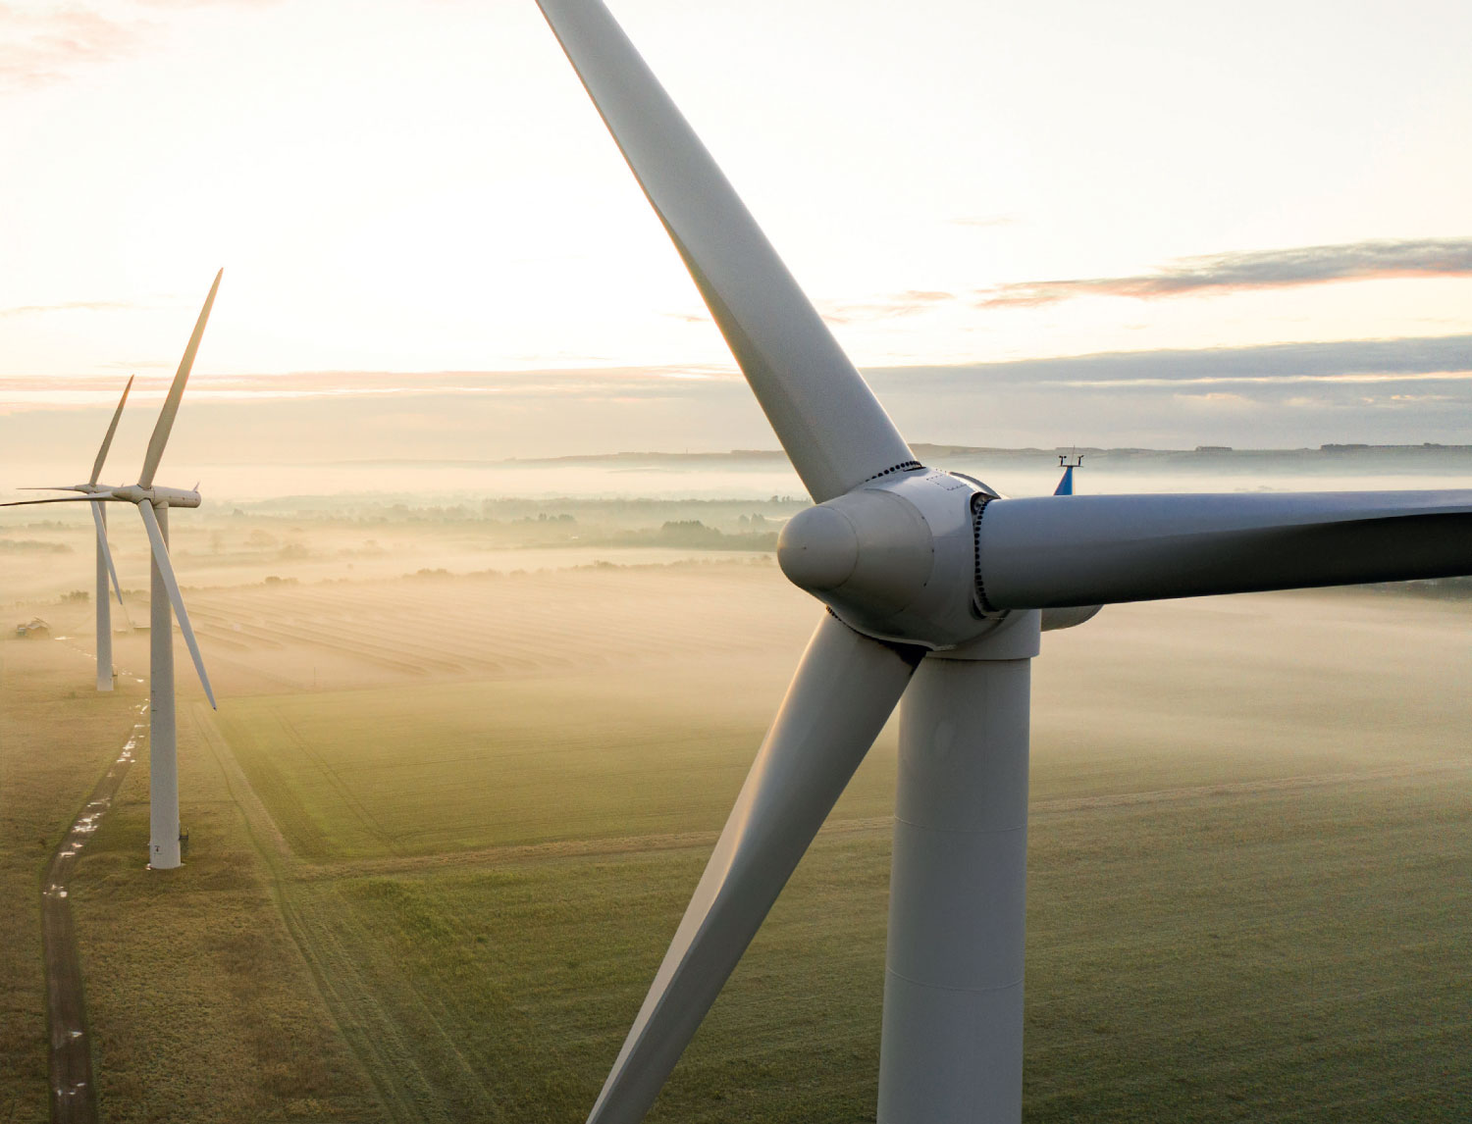
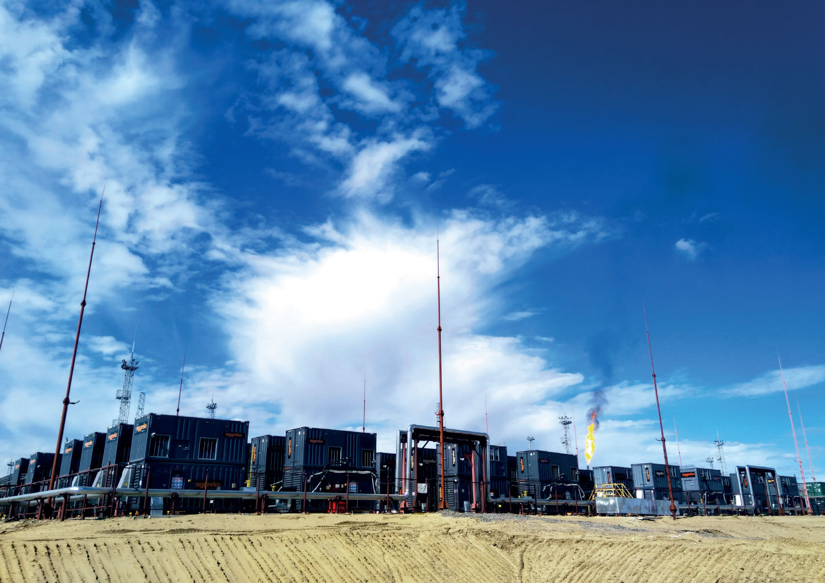
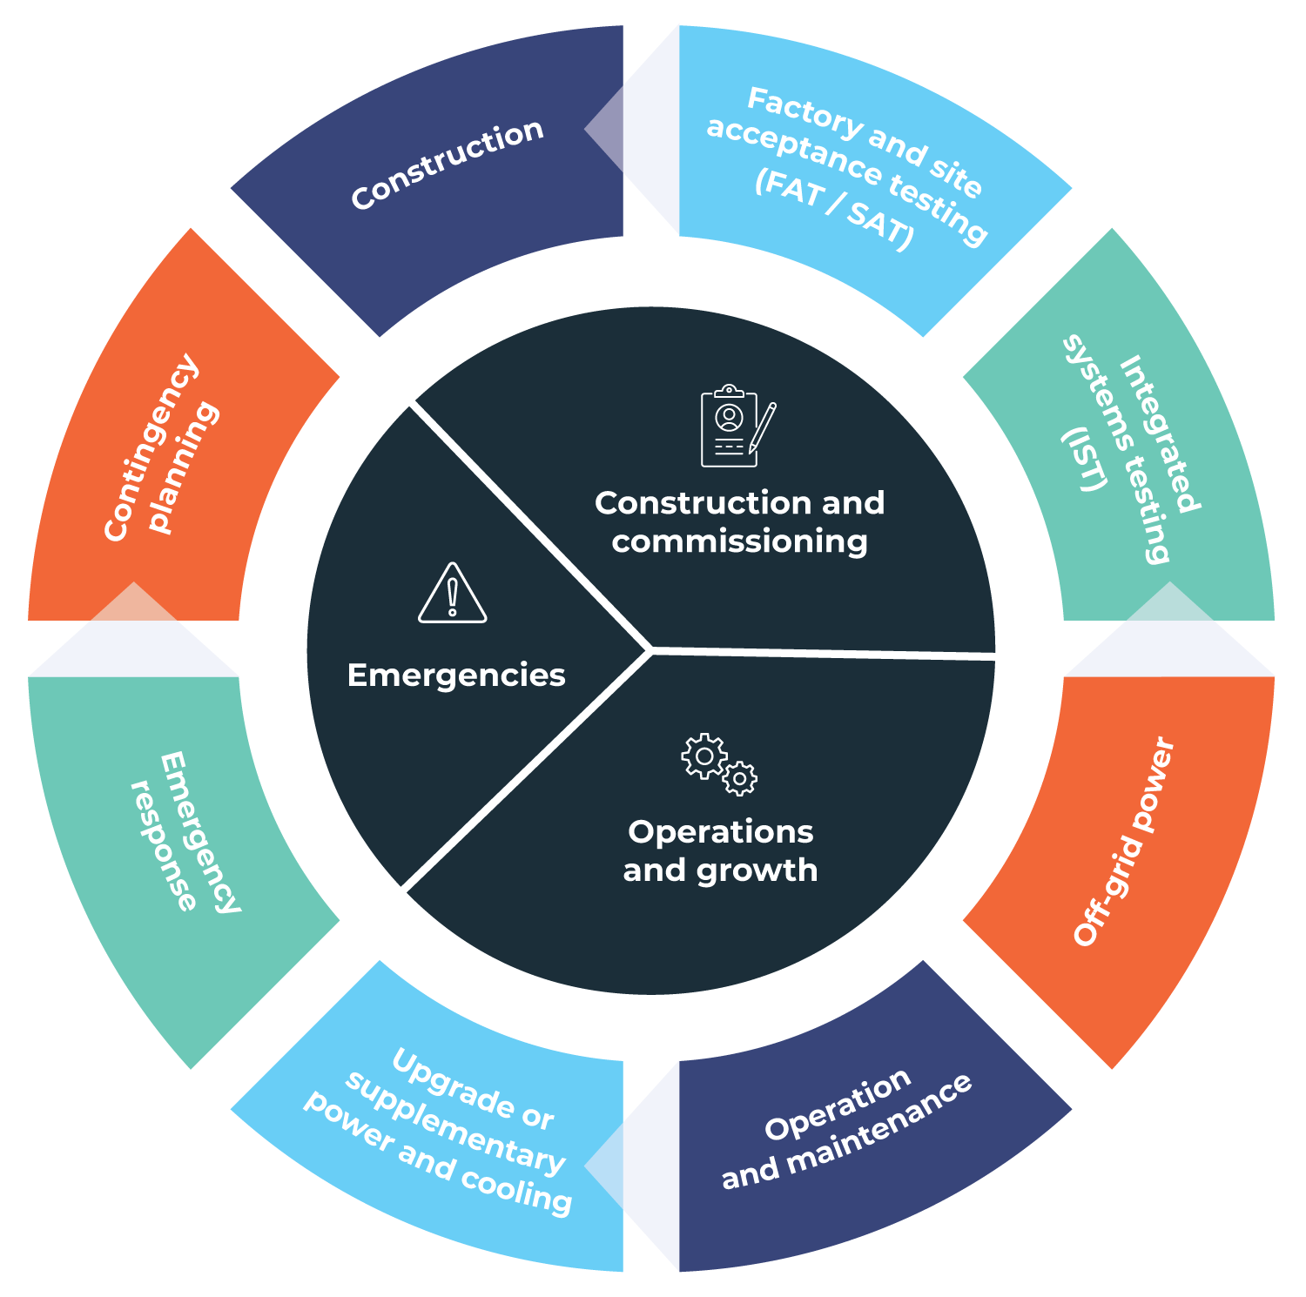
Wind farms
Aggreko has been working with the
wind farm industry since it started,
so we know each stage of the design
and construction phase brings
unique challenges.
Whether you’re working onshore or
offshore, we have over 50 years of
experience and an in-depth understanding
of the power and temperature control
needs of your wind farms.
We can work with turbine manufacturers, wind farm operators and contractors to help you deliver complex wind turbine commissioning solutions making us your ideal partner throughout your wind-farm lifecycle.
Flare gas
to power
We can help you generate power from
Associated Petroleum Gas (APG) to reduce
costs, gas flaring and your carbon footprint.
As a key global player in this market, we
have more than 1 GW of installed power
capacity for projects using APG as their
fuel totalling more than 180 customer
projects in every corner of the world.
We are materially reducing customers’
cost of energy by using this previously
flared gas to power their operations or
export it to the grid. APG can be used
for your own needs to reduce your
operating costs or create a new revenue
stream when sold to a third party.
We can engineer a bespoke solution to
match your individual needs and provide
full turnkey, dependable solutions while
ensuring power reliability and the highest
of safety standards are maintained.
With all our experience, we understand exactly what it takes to setup a successful wind farm and keep it at optimal productivity and efficiency throughout its life.
When you partner with Aggreko you’ll have peace of mind that your operations are in safe hands from day one.

Slide 9
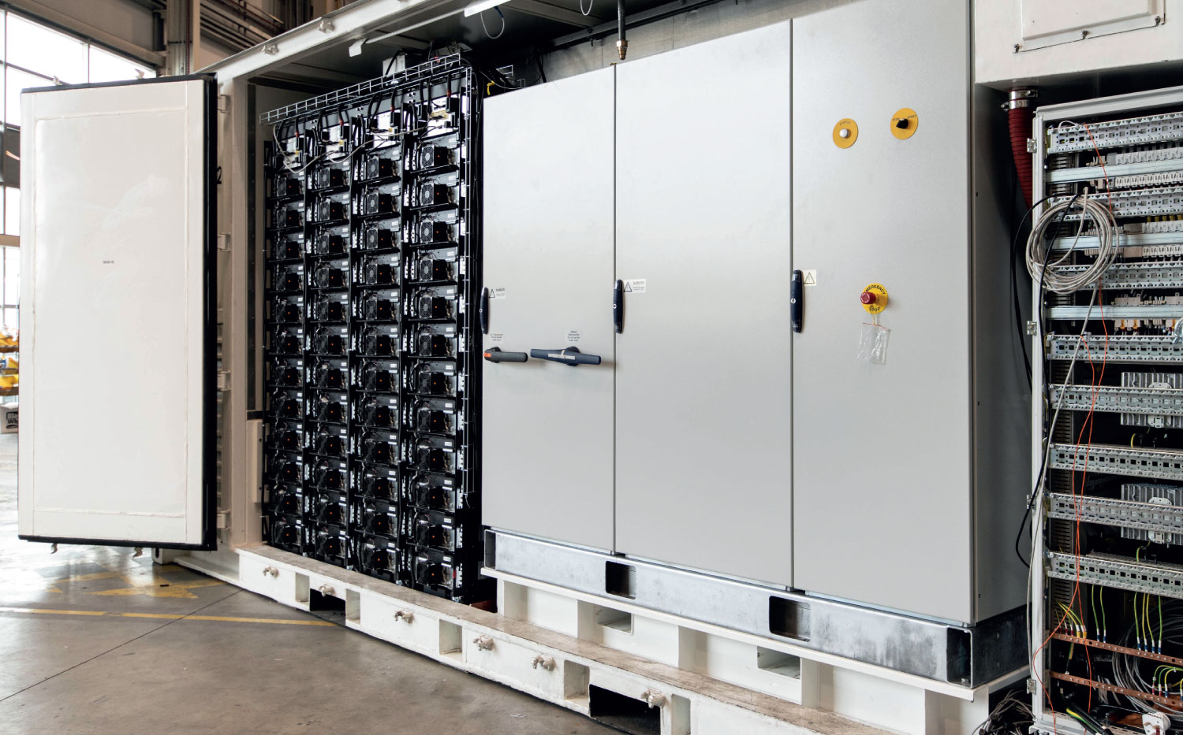
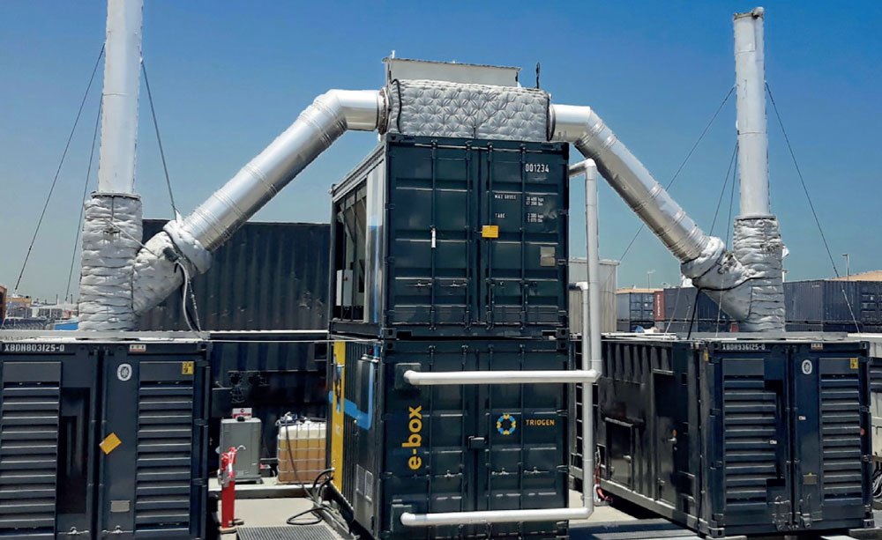
ORC
technology
(Organic
Rankine
Cycle)
We can turn heat from our generator exhausts into useable energy. A single ORC unit setup next to your generator saves about 300,000 litres of fuel per year, or about six fuel trucks. As diesel gensets convert only 40% of the fuel energy into electricity, the rest is wasted.
ORC technology converts the exhaust gas heat into additional power and thereby reduces the fuel consumption of the genset by 5-10%.
Lower your carbon footprint and
save fuel:
Ships in two stackable 20 ft shipping containers
No interference with genset performance or project operation
Stress tested under intense humidity and ambient heat of more than 50°C
Runs without supervision – remotely controlled
Battery storage system
Our fully integrated, plug-and-play battery storage solutions ensure maximum system effectiveness and efficiency. We offer ready-to-install battery storage systems, comprised entirely inside modular containers.
This mobile and modular solution includes batteries, inverter, HVAC, fire protection and auxiliary components, all tested and pre-assembled by Aggreko experts, and seamlessly operated by our smart software.
Our battery packs can be delivered and
deployed almost anywhere. Single units can
be easily combined to deliver the power and
energy capacity required for your business.
The system can cover a variety of applications
from 1 MW up to multi-MW power output.
And what’s more: We take full responsibility
for your system design, installation,
performance, maintenance and for the end
of life of the batteries and their recycling.
Talk to us today
We can help work out the right solution for your mine or project:
1800 808 109

Slide 10
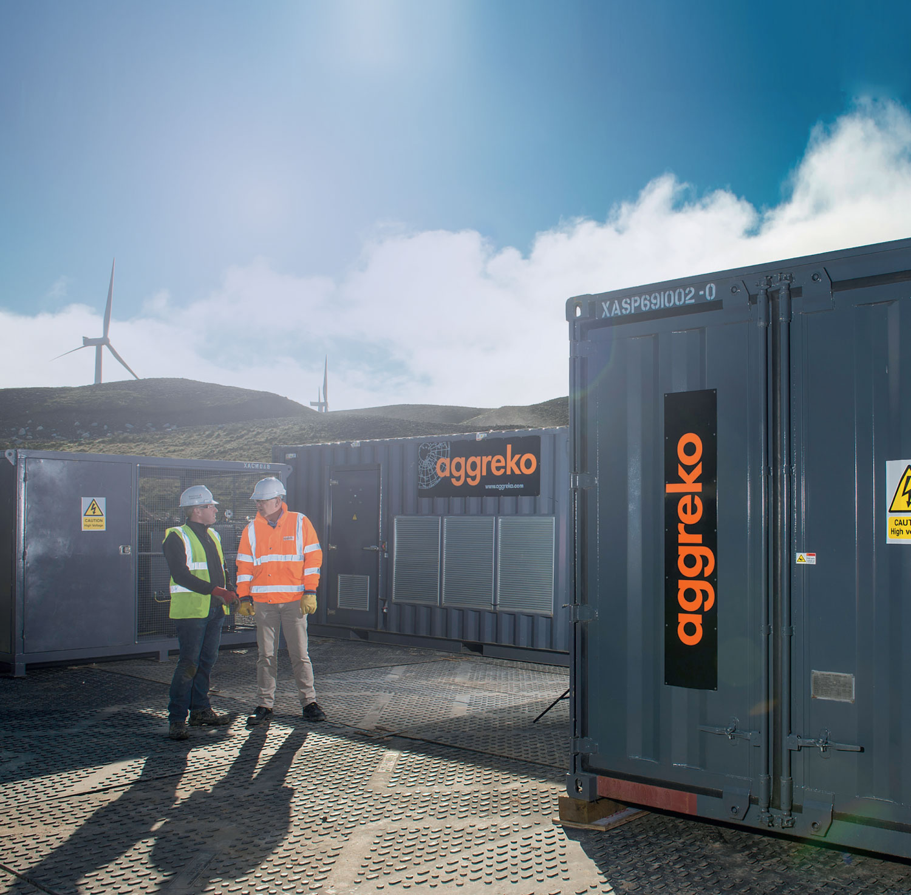
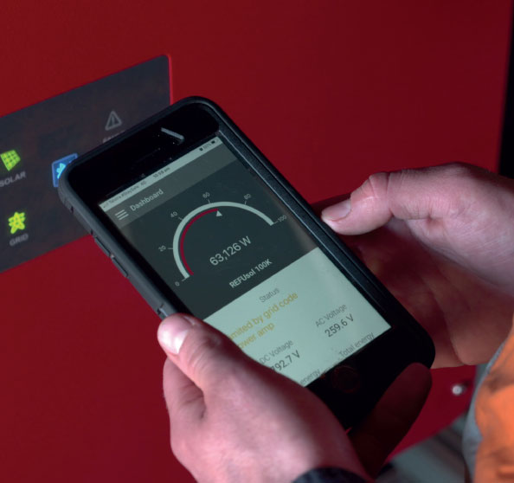
LONG-TERM POWER
Partner with Aggreko
to power the life of
your project
Benefits of our world-leading energy solutions
Technology
and safety
All safety and QHSE compliance requirements met (ISO 9001, ISO 14001 and ISO 45001).
Not being tied to current technology and access to new technology and upgrades when available.
Visibility and remote monitoring of assets 24/7.
Flexible
Commercial
contract
Under a flexible BOOM contract Aggreko will provide the capital, own, operate and maintain the facility. We take care of all maintenance and upgrades as new technology becomes available. Best of all, we have our 24/7 remote monitoring and support to ensure the project runs efficiently.
Security of supply
Security of power supply, ensuring your system works from day one
We are a global company, with global supply and technicians
Transparent fuel costs and guarantees
Fuel costs and supply risks are minimized with hybrid solutions and added renewables
Managing and mitigating risk
We’ve been delivering power to the mining,
oil and gas, and utilities industries for decades. We’re experienced and we are constantly striving for innovative ways to deliver better and cleaner power solutions to you.
Our Flexible Build –
Own – Operate –
Maintain (BOOM)
contract frees up your capital for
use elsewhere in your business.
It is a cost-effective solution for
any location and is tailored to suit
your site’s size, environment, and
your company’s ESG requirements.
Power can be scaled up or down to fit in with project lifecycle unlike fixed power plants
No up-front capital costs (CAPEX) and costs are incurred monthly or as outlined in contract
Flexible contracts, with early termination options available for longer term projects, reducing financial and operational risk
Budget visibility and predictability over power costs e.g. achieving the lowest levelized cost of power for the site
Maintenance costs and risks are mitigated. Also, because we are modular, we can add or remove storage or generation when needed (for example if a unit needs replacing)

Slide 11
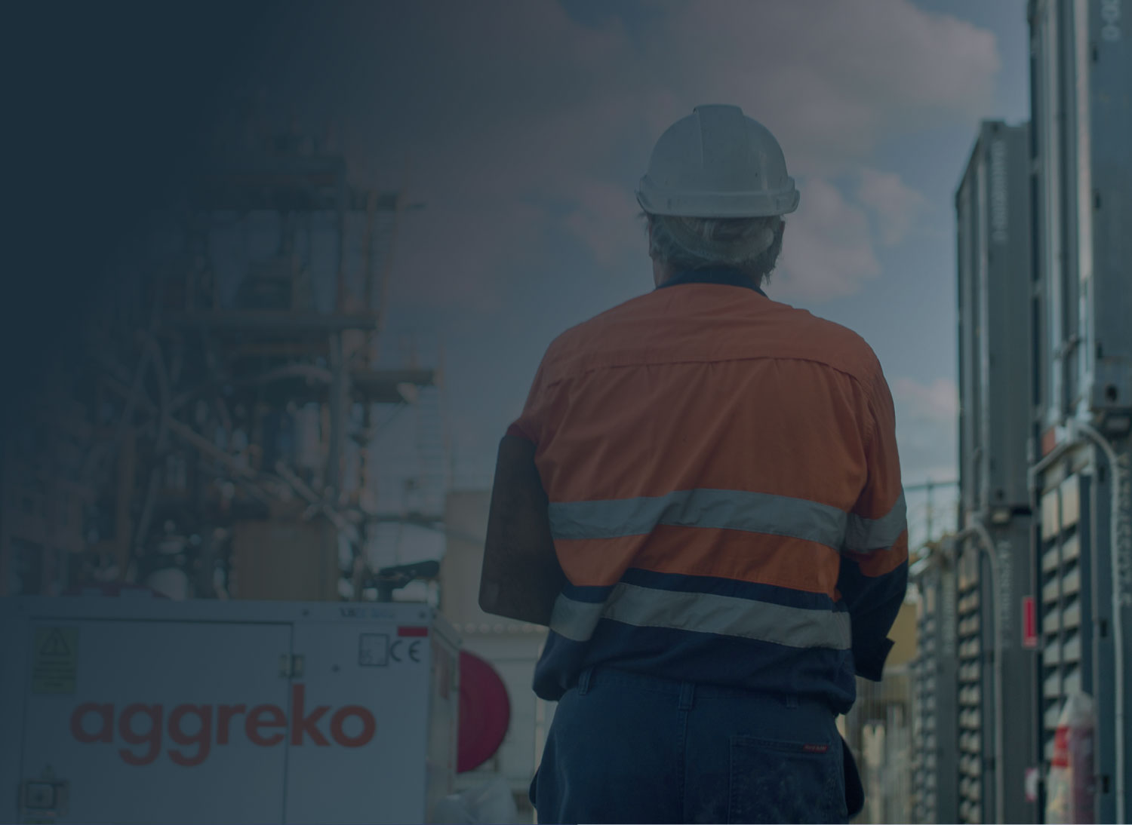
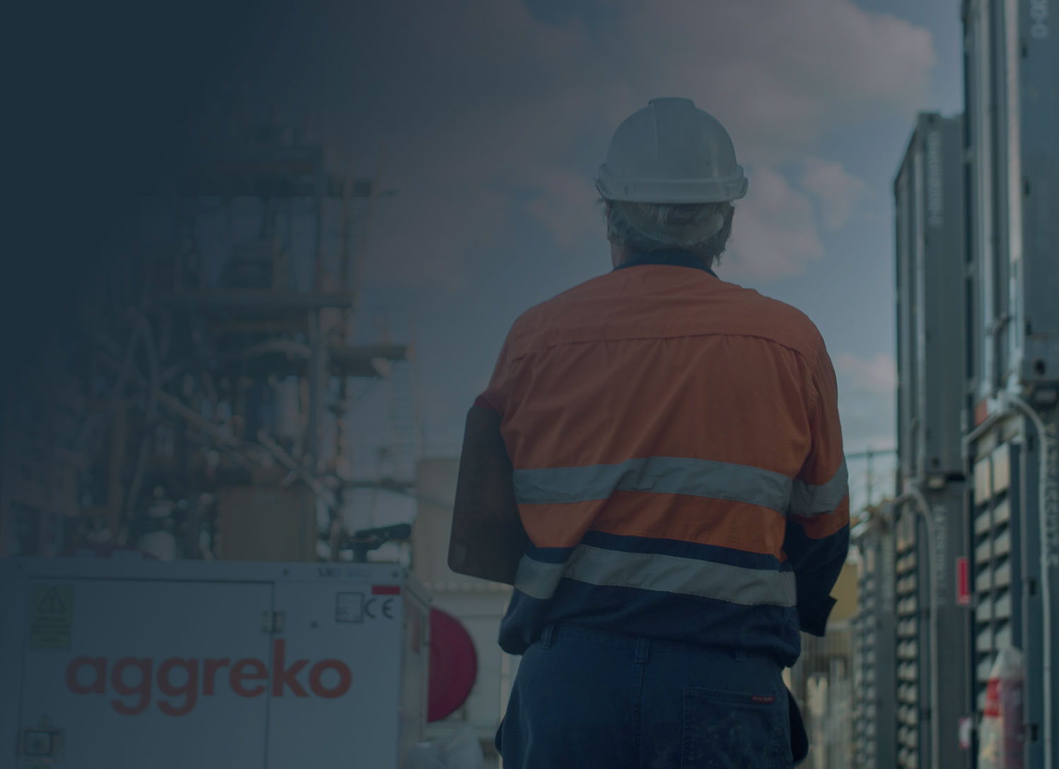
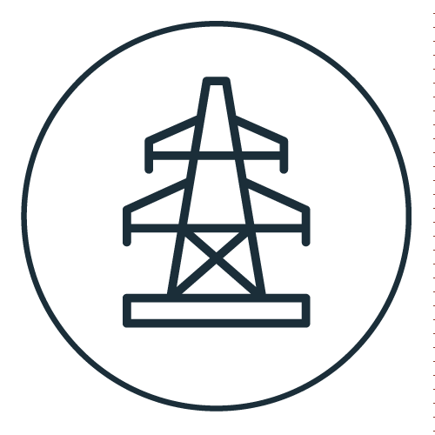
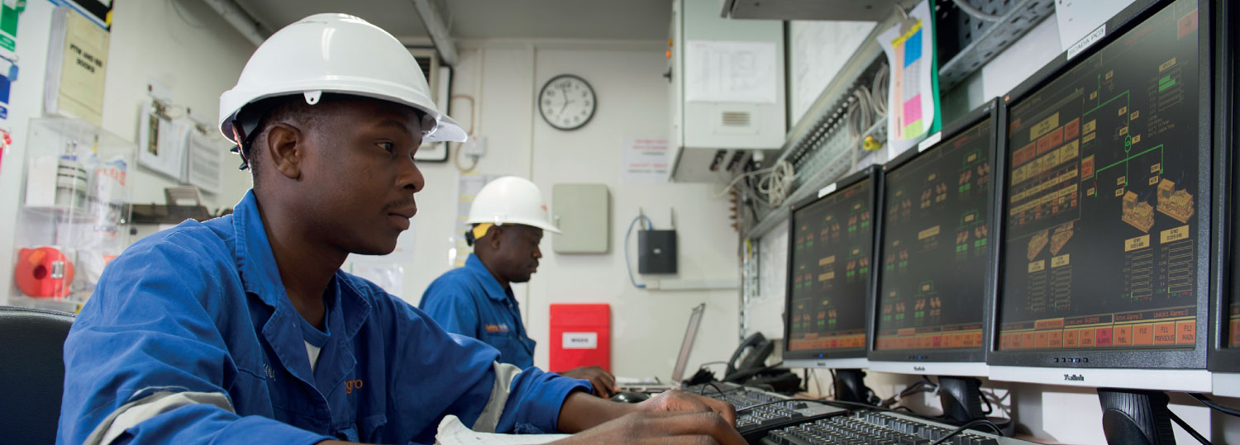
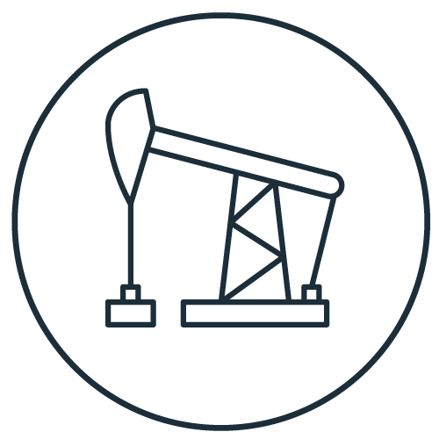
LONG-TERM POWER
Sectors we help
Utilities
We keep power flowing to your customers
From supplying power for day-to-day
operational needs to powering entire
mines, our experts help businesses
around the world improve production,
manage power generation and plan
for emergencies.
Our energy partnerships are particularly
appealing for long-term projects in the
following sectors:
We believe our power generation, transmission, and distribution expertise is second to none. Whether you’re bringing a power plant online or need flexible power and distribution during planned or unplanned outages, Aggreko has a trusted track record.
We know that no two plants are the same. So instead of supplying off-the-shelf rental equipment, we listen to your needs, work out the best approach, then engineer, deliver, install, monitor, and maintain the best solution for the job.
Most of the time, this means we custom design power systems for our customers, and this is where we excel. Our electrical engineers and industry-savvy technicians are certified to work in the utilities industry, which means we know how to reduce outage days, keep customer interruptions to a minimum and maintain a safe working environment.
You’ll be in safe hands with us as your utility partner.
Mining
Oil and gas
We’re with you from start to finish
Mining operations are long term projects
– so we support you at every stage. We’re
with you for exploration, project planning,
site construction, commissioning and
production – providing technical advice
and expertise when you’re ready to expand.
We’re even by your side to help with
closing the mine at the end of its natural
life span. However remote your mining
location is, we’ll take care of the power,
heating and cooling systems, freeing
you to concentrate on the mining
We’re your dedicated engineering partner
In an industry where no two operations
are the same – and where every dollar
counts – you don’t want a rental company.
You need an engineering partner. We have
unrivalled expertise in designing energy
management systems for the oil and gas
industry. This means we can support you
through your project life cycle, from start up and testing, to drilling, to production
and decommissioning. Whether you’re
operating upstream, midstream or
downstream, we can help you to work
more efficiently. It’s what we do.
Aggreko’s control platform for peace of mind
The Aggreko Control Platform is the final piece of the energy management puzzle. The system integrates with our thermal, PV and battery storage systems to provide a secure, simple and reliable platform for the management of distributed energy resources (DERs) to solve complex energy problems.

Slide 12
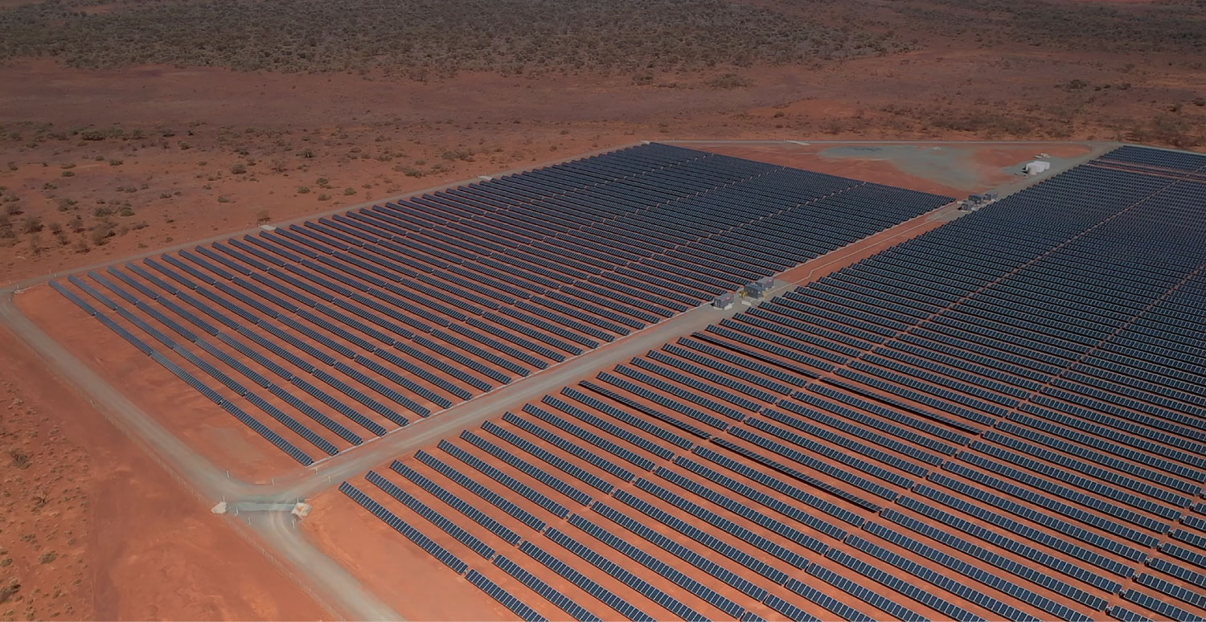
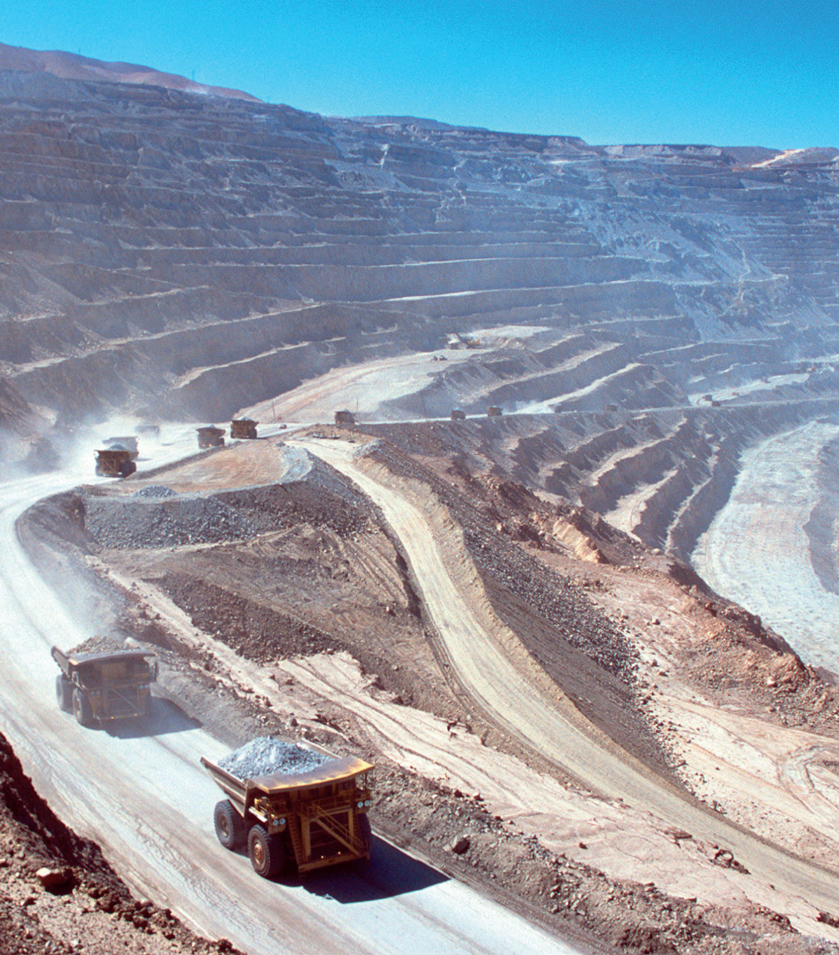
CASE STUDY OFF-GRID HYBRID POWER PLANTS
THE SOLUTION
One of the world’s largest renewable microgrids powers remote gold mine
Leverage the benefits of hybrid energy and minimise
capital outlay
To integrate almost 8 MW of solar power generation and 2 MW / 1 MWh battery storage with the existing gas supply as a hybrid power station – under one contract and with no capital outlay.
This unique energy package combines more than 20,000 solar panels, thermal and battery storage that’s seamlessly integrated and managed by our powerful software platform - guaranteeing full system availability and optimising their existing thermal assets life.
This new solar gas hybrid power station will meet the increased daily power needs of the entire mine of 24.2 MW, with 8 MW allocated to the Wallaby underground mine and the remaining power for the processing plant, associated facilities and the mine accommodation camp.
In total, the solar, thermal and battery storage assets will produce around 18 GWh of energy every year, with carbon emissions at the mine expected to be reduced by approximately 9,500 tCO2e.
CUSTOMER
Gold Fields Australia
KEY FACTS
THE IMPACT
LOCATION
Laverton, Western Australia
2 MW
Battery storage
27 MW
Gas power
Lower energy costs and
minimised environmental
impact
SECTOR
Mining
23,040
Solar panels
7.7 MW
Solar power
Power generation is a significant proportion of
operating costs of the Granny Smith mine for
Gold Fields.
Using the latest hybrid energy technologies will enable them to significantly lower their total cost of energy and reduce their carbon footprint, while demonstrating their ongoing commitment to both environmental sustainability and innovation at its operations. All of this without compromising the reliability of power supply and productivity of the mine.
THE CHALLENGE
Help our customer introduce renewables into their energy mix without compromising power reliability
Gold Fields Australia committed to reduce its carbon footprint and use renewables for at least 20% of total life-of-mine power requirements in new projects.
Two years previous, after a gas line extension was built by AngloGold Ashanti to service their mining operations in the region, Gold Fields Australia were able to use gas, a cleaner cheaper fuel source than the diesel it was using at the time to power their operations going forward.
That’s when they turned to Aggreko to deliver a gas power station. Working closely with them to understand their needs, we delivered highly efficient bespoke modified engines that reduced their fuel costs and environmental impact.
Knowing Aggreko had recently announced the launch of microgrids-as-a-service for customers who want to leverage the benefits of a hybrid energy solution while minimizing capital outlay, discussions began about how and if this could be incorporated into their current power package without compromising the micro-grid stability or reliability.
OUR DIFFERENCE
Reducing your footprint - as well as your costs and risk
Customer
feedback
The Granny Smith microgrid and the renewable energy solution at our Agnew mine are a clear demonstration of the innovative steps we are taking to ensure the ongoing sustainability of our operations.

Slide 13
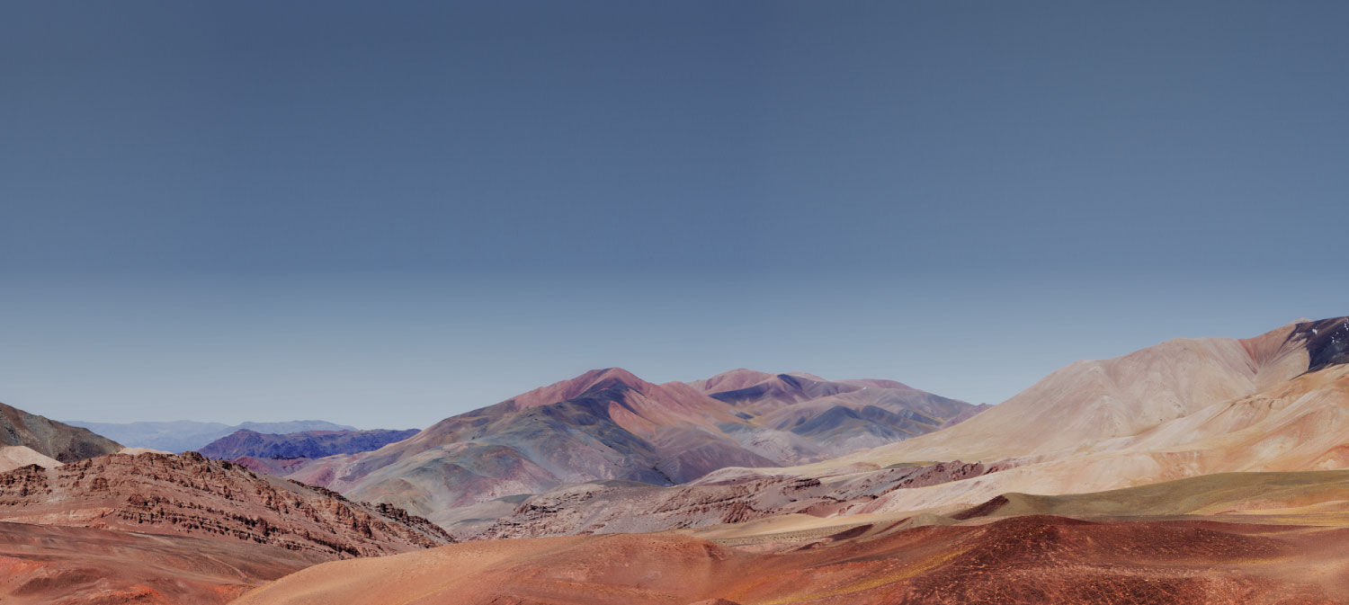
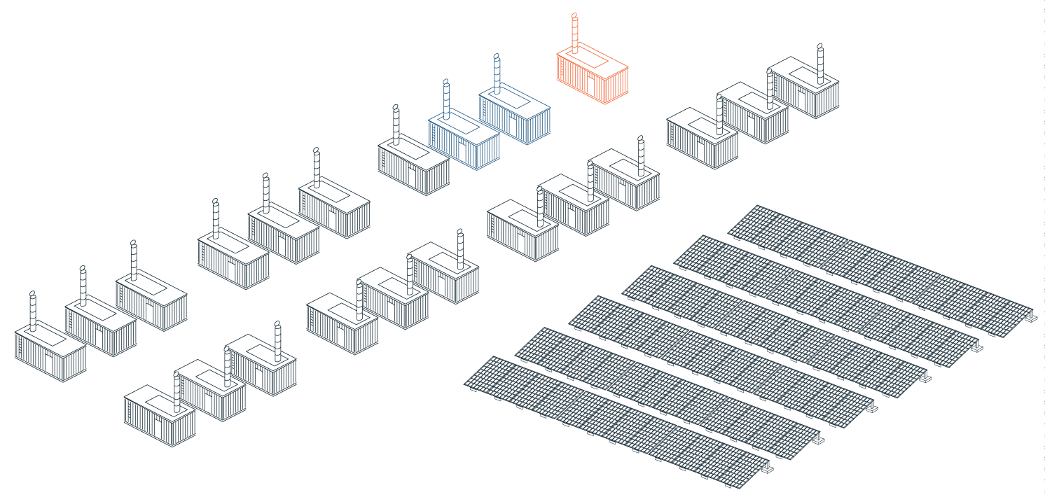
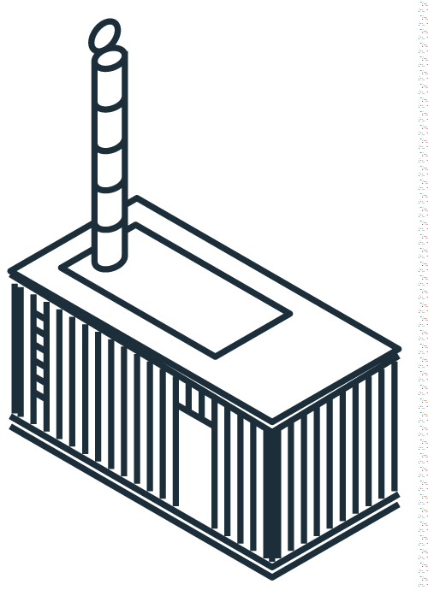
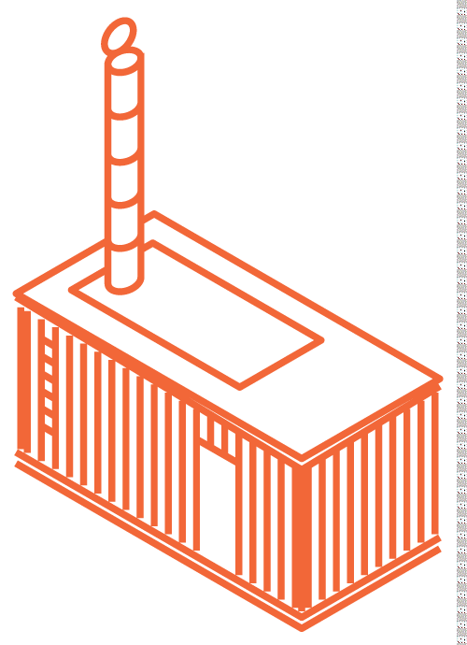
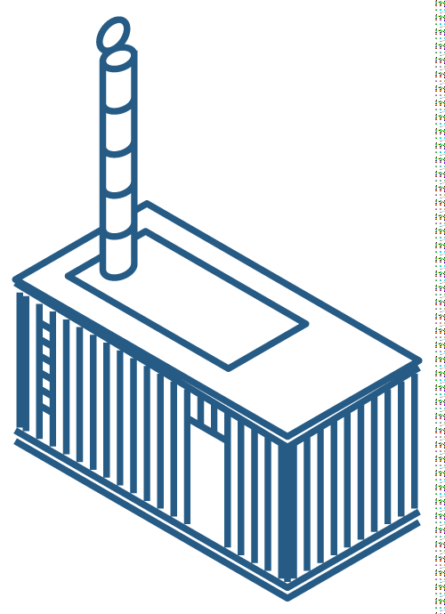
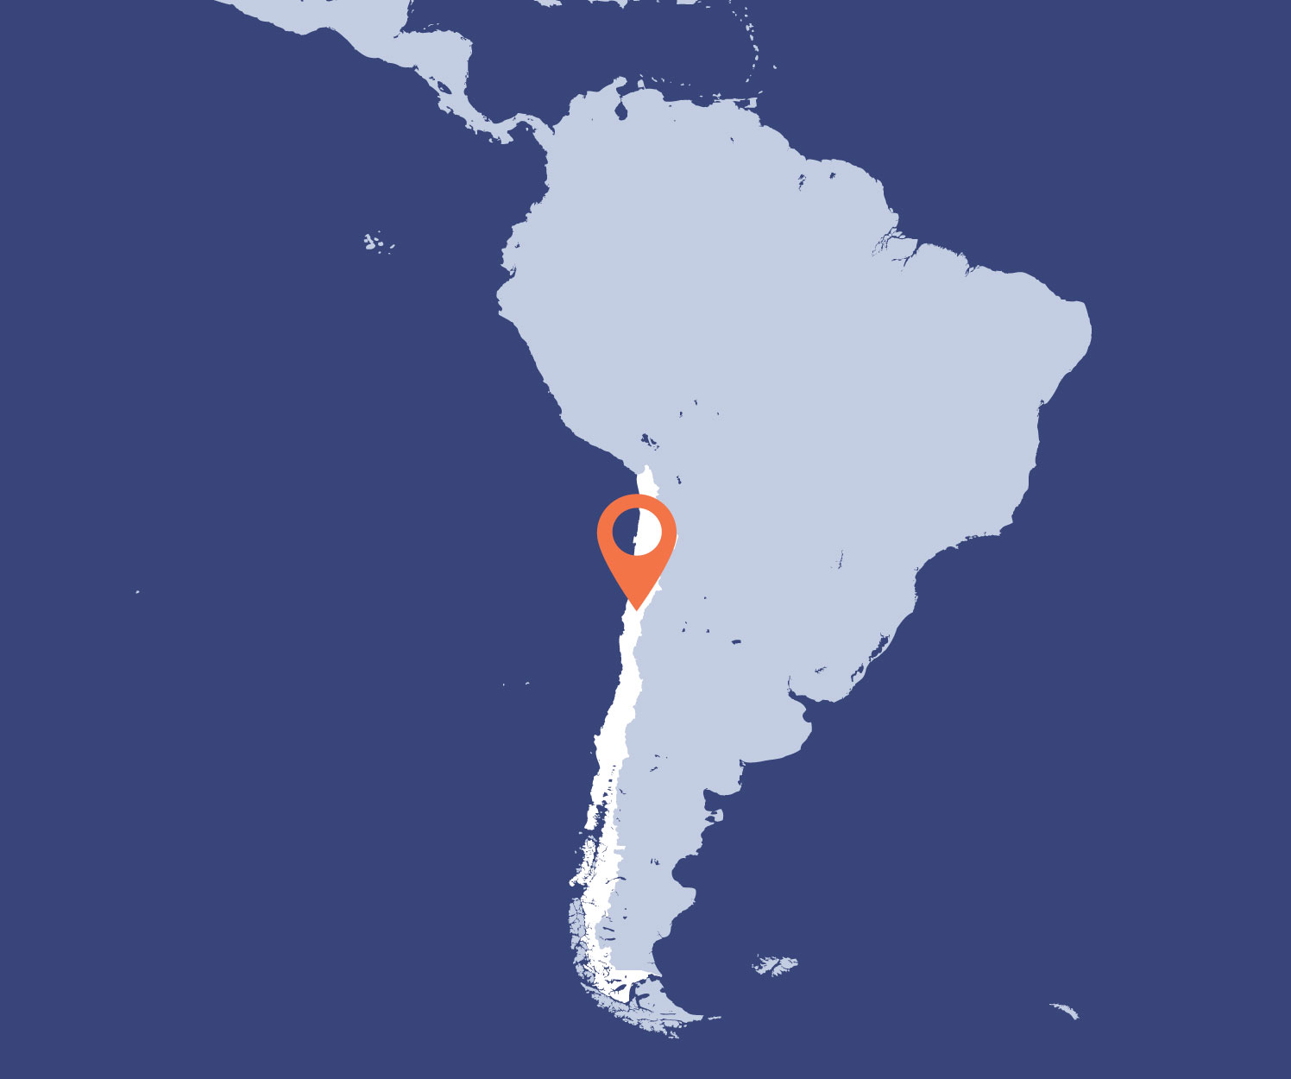
CASE STUDY OFF-GRID HYBRID POWER PLANTS
GENERATION POINT 1 (GP1) - DIESEL AND SOLAR PV
Hybrid power solution to reduce costs and emissions for a gold mine in the Andes mountains
19 Running
1 Spinning reserve
2 Cold reserve
CUSTOMER
Gold Fields
Salares Norte Mine
KEY FACTS
The specifications of each generation point (GP) are:
16 MW
Of diesel
9.9 MW
Of solar PV
HYBRID POWER SOLUTION (10 YEARS):
LOCATION
Atacama region of Northern
Chile - Altitude: 4,500 m
$7.4 Million
Cost of energy savings
$1.1 Million
Of carbon tax savings
of reduced emissions
104,000 tonnes
Of carbon
emission reduction
Generation point 1 (GP1)
Estimated peak power demand: 14.7 MW
22 G3+ genset (19 running - 1 Spinning
Reserve – 2 Cold Reserve)
Solar PV: Mirador Alto - 5.9 MW,
Platform Botadero - 3.1 MW and
Platform 15 - 0.9 MW
Generation point 2 (GP2)
Estimated peak power demand: 0.64 MW
2 G3+ genset (1 running – 1 Cold Reserve)
Generation point 3 (GP3)
Estimated peak power demand: 0.5 MW
2 G3+ genset (1 running - 1 Cold Reserve)
SECTOR
Mining
THE CHALLENGE
Providing reliable power at extreme conditions
EARLY CONSTRUCTION POWER (1 YEAR):
Generation point 4 (GP4)
Estimated peak power demand: 14.7 MW
2 G3+ genset (1 running - 1 Cold Reserve)
Generation point 5 (GP5)
Estimated peak power demand: 0.7 MW
2 G3+ genset (1 running - 1 Cold Reserve)
Following on from Aggreko’s successful work at the Gold Fields’
Granny Smith mine in Western Australia, where we created one
of the largest renewable micro-grid projects in the world, we
will work to provide a unique and market-leading hybrid power
solution for a new Gold Fields’ open pit mine in Chile, Latin America.
THE IMPACT
$1.1 Million
of carbon
tax savings
of reduced
emissions.
$7.4 Million
cost of energy
savings across
10 years
Ahead of the mine’s official opening, Aggreko will work as the site’s sole power supplier, delivering a sustainable solution to fulfil the unique needs of the site.
The modular, high-altitude-efficient diesel gensets will work to provide reliable power to all generation points at the site, incorporating both Spinning and Cold Reserve units, adding an additional level of security and reliability.
This project is the latest in a number of projects globally where Aggreko has worked hand-in-hand with a range of customers to meet specific demands in unique conditions, and it highlights our commitment to providing innovative solutions that minimize the impact on the environment in which we operate.
For this particular project our solution will deliver a total of $1.1 Million of carbon tax savings and cost of energy savings of $7.4 Million across 10 years.
THE SOLUTION
A tailor-made hybrid power solution
featuring Aggreko’s largest Solar PV
installation in Latin America - 16 MW
of diesel + 9.9 MW of Solar PV

Slide 14
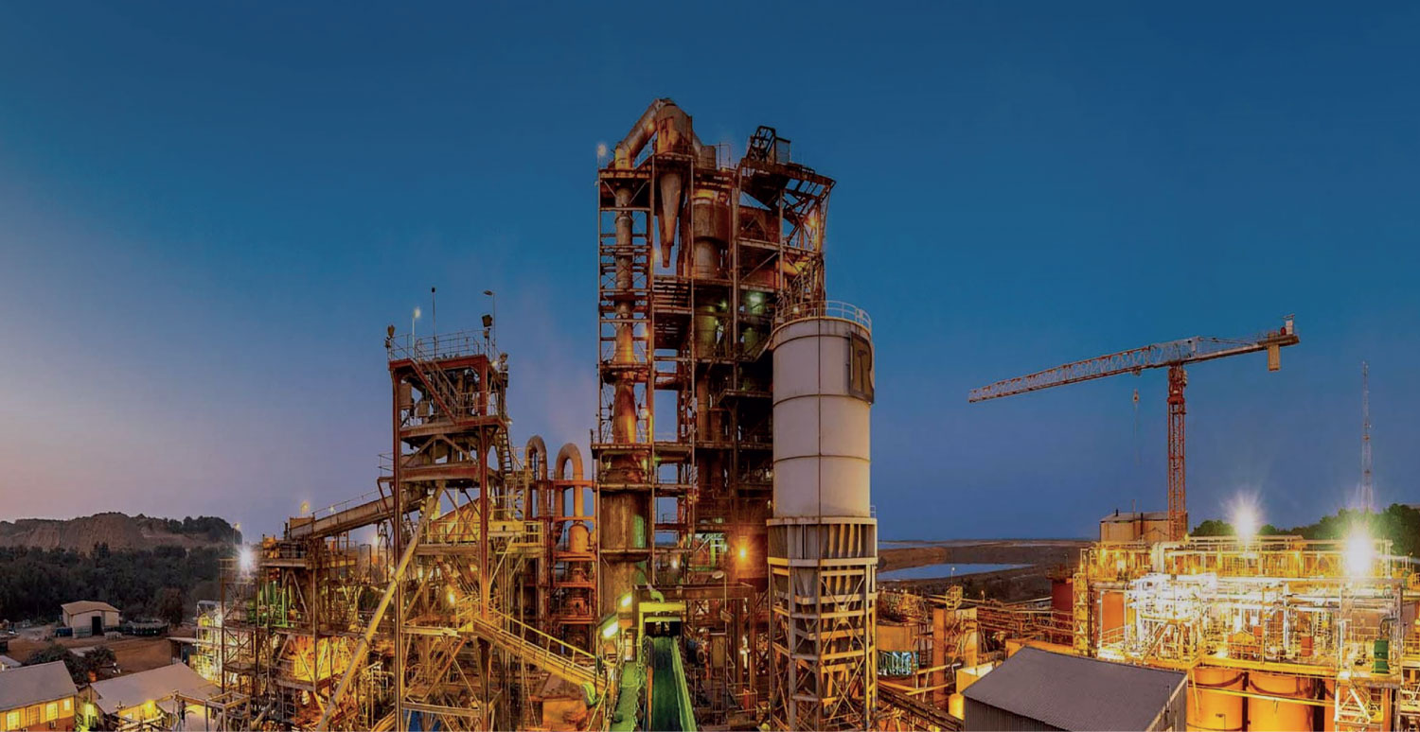
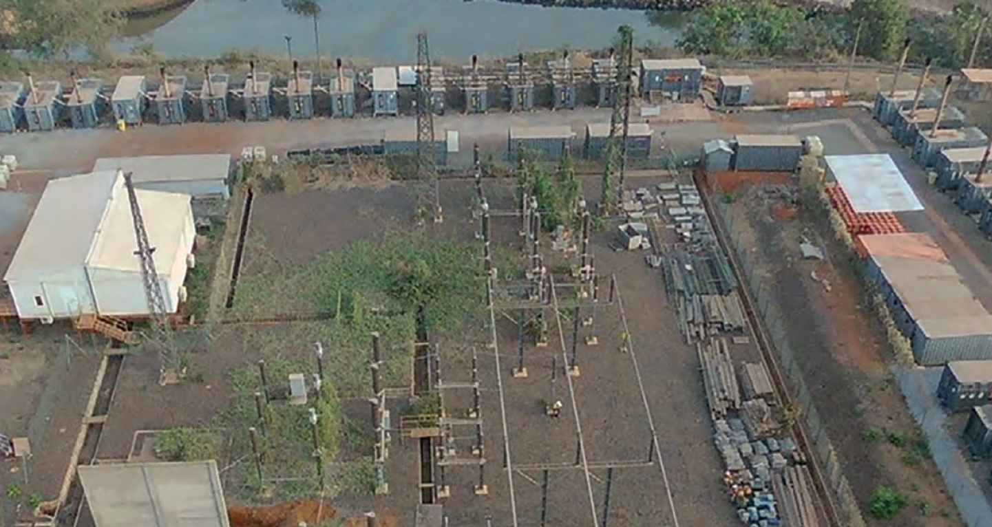
CASE STUDY OFF-GRID HYBRID POWER PLANTS
THE SOLUTION
As Aggreko had been providing and operating a 28 MW diesel power plant on the site that augmented the existing diesel power station for a few years, we had both the reputation and credibility to step in and offer to support the optimisation and hybridisation of their plant. A vast project needed a vast solution, and we relished the opportunity to work with Resolute to deliver a bespoke cutting edge technical and commercial solution as part of a 16-year Power Purchase Agreement (PPA).
Technical Offering
Delivered in two stages, it considered the various project factors with a meticulous level of detail to ensure smooth delivery and zero disruption to the mine’s production activity. Stage one was completed in 2021 and consisted of three 10 MW thermal Wartsila Modular Block’s and a 10 MW battery storage system, that provides spinning reserve displacement and outbalance sudden jumps in load. The second stage will consist of the installation of an additional 10 MW Wartsila Modular Block and the addition of 20 MW solar PV power.
There can be some hesitancy to implement solar as mine’s have short planning horizon’s and the usual lifespan of a PV park is about 20 years – if not sometimes longer than the operation of a mine itself. This is why the offering Aggreko provides perfectly matches a mine’s needs.
The initial site infrastructure layout includes space to accommodate a fifth 10 MW Wartsila Modular Block, enabling the mine to additional capacity power if needed in the future to support growth or expansion plans.
Cost effective hybrid power that lowered gold production costs
Once the solar power system is installed, the 10 MW battery storage system will also manage the output of the solar power system, smoothing out fluctuations in PV generation and facilitating integration into the hybrid system.
Commercial Offering
Our pricing was structured with a combination of fixed and valuable charges depending on electricity required, and evolving MW installed. It also includes an incentive programme where Aggreko shares between 25% to 50% of the resulting fuel savings if improved efficiencies for key performance indicators in the contract are achieved. This provides us with an incentive to reduce the cost of power for Resolute, and we share that cost benefit directly with our customer.
During the project engineering phase, we forged a true partnership with Resolute to ensure we use the best site infrastructure, and optimise the civil work and installation of the plant. As an example, the solar array will be constructed on the surface of the existing Syama Tailings Storage Facility (STSF) thereby maximising positive environment outcomes and augmenting Resolute’s rehabilitation program.
CUSTOMER
Resolute Mining Limited
KEY FACTS
LOCATION
Mali, Africa
40%
Cost reduction in total cost of energy
20%
Reduction in
CO₂ emissions
16 year
Contract to build, operate and maintain hybrid plant
SECTOR
Mining
THE CHALLENGE
Resolute Mining Limited, an ASX and LSE listed gold mining company has produced over eight million ounces of gold from 10 gold mines.
As part of its commitment to delivering a life-of-mine-all-in sustaining cost of US $746/oz at its Syama Underground Mine in Mali, they needed to define a lower cost power solution relative to its existing source of power.
The Syama Gold Mine was powered by singular diesel generators that were no longer the most efficient compared to newer technology now available. At the mercy of diesel, notoriously a fluctuating high-cost fuel, it has become an expensive solution.
Furthermore, the generators had to run constantly to provide system stability that the mine needed.
After investigating, the possibility of a grid connection, which was disregarded based on time and cost, Resolute launched a tender with the target of achieving a 40% reduction in the cost of electricity (COE). With Resolute focused on securing a more environmentally friendly solution, the environmental impact of the power solution being offered was a key consideration.
Resolute also wanted a solution which offered low-cost power without needing to make a significant upfront capital investment so that the Company could conserve capital for deployment for growth.
THE IMPACT
The energy as a service agreement with this hybrid offering allows Resolute to focus on their core business of Mining while delivering substantial cost savings, estimated at 2 million euros per month on their current total cost of energy – that’s a 40% reduction from current COE. These savings will flow directly into Resolute’s production cost per ounce and help them operate in any gold price environment, which is crucial for the long-term sustainability of their mining operations.
Once the Solar power plant is integrated into the mine’s energy mix, Resolute will also improve the mine’s environmental impact with a reduction in carbon emissions of approx. 20%. The ongoing presence of Aggreko at the site, and appetite to adopt a new world leading technology demonstrates the trust and strong partnership in place.

Slide 15
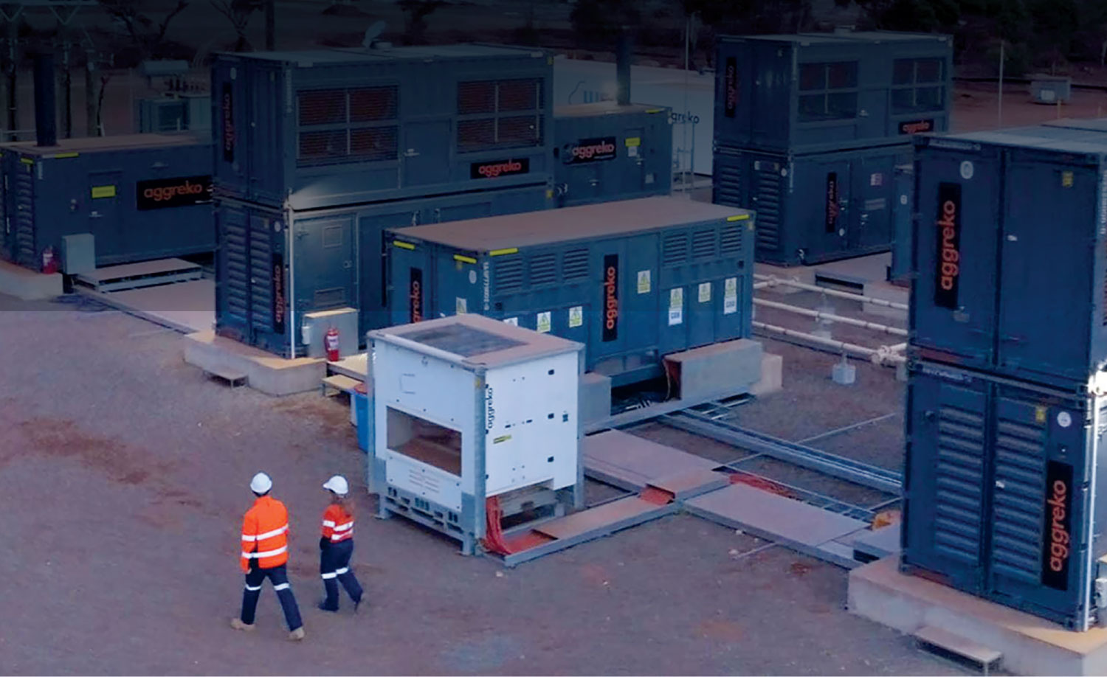
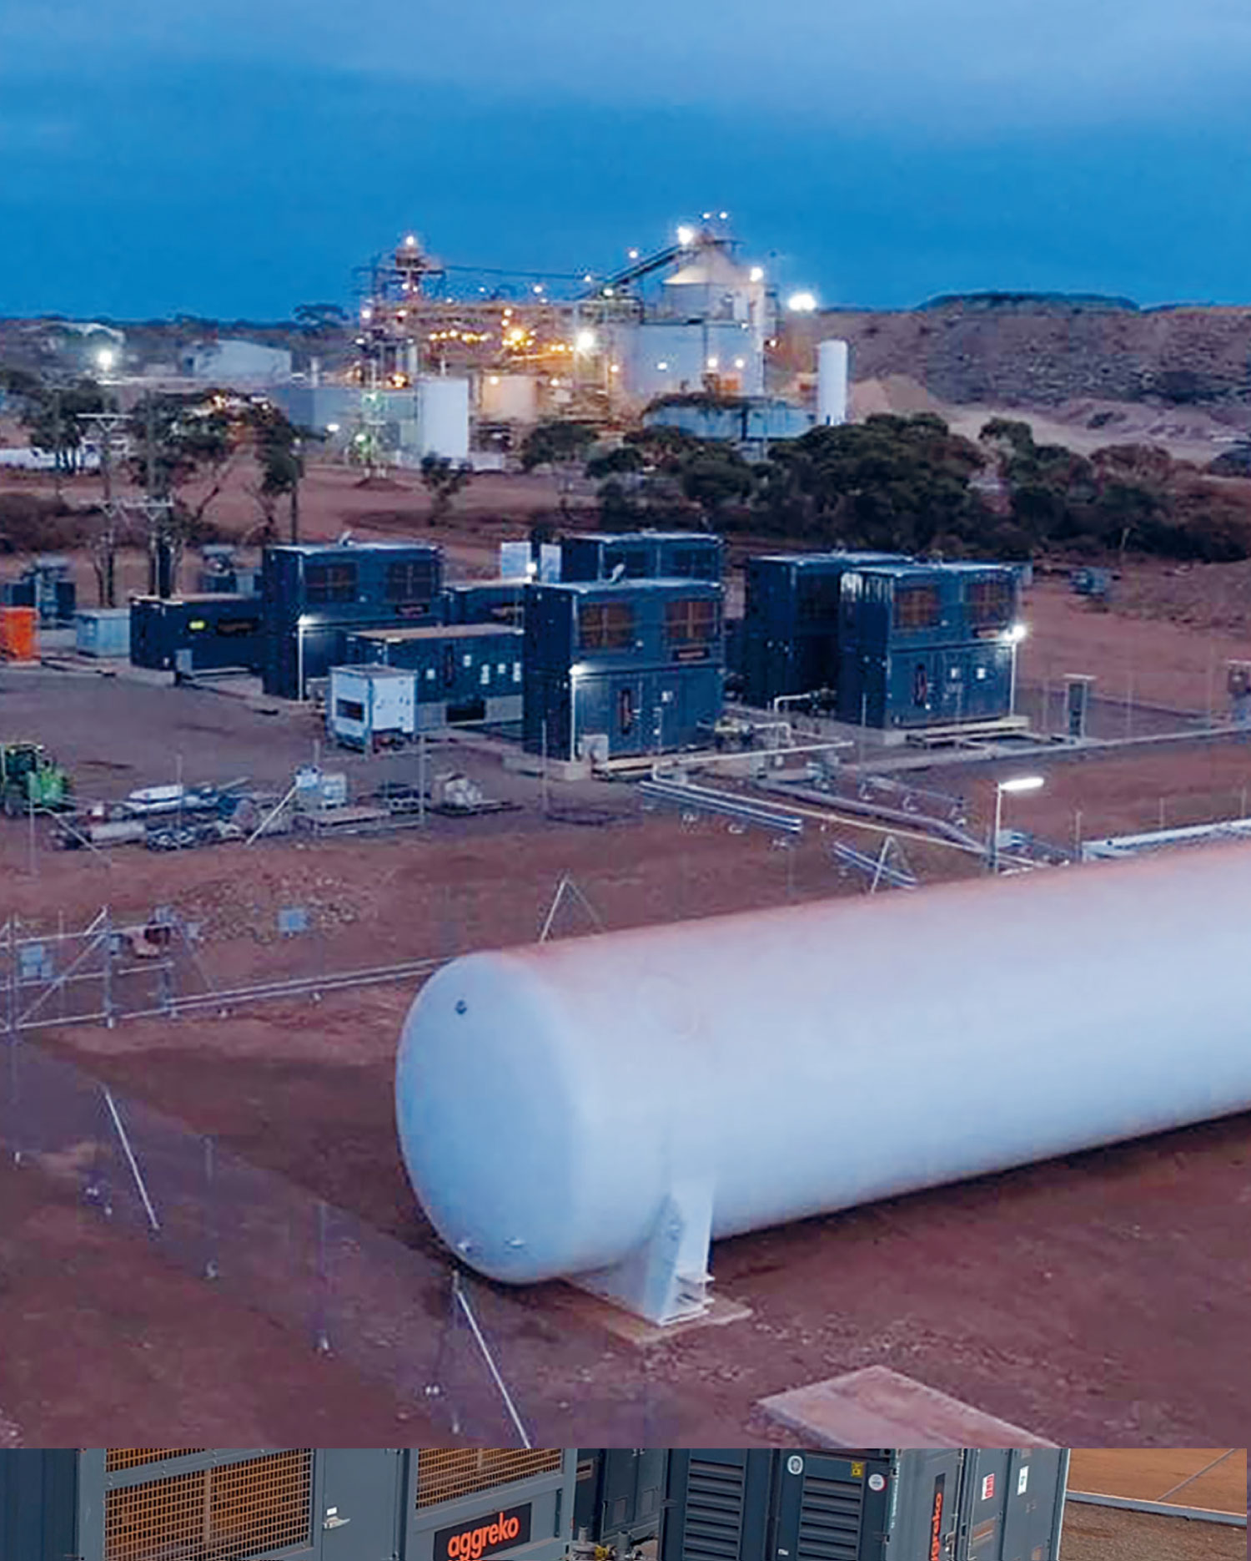
CASE STUDY OFF-GRID HYBRID POWER PLANTS
Virtual gas plant minimises
emissions for miner
THE SOLUTION
Combined virtual pipeline
of LNG gas and diesel power,
scalable with demand
We carried out a thorough analysis of the power requirements of the entire site and estimated
that a total of 8MW would be needed.
To meet this, we installed 5 LNG gas generators
and 2 diesel generators. The new power station
was fully commissioned in December 2020,
ready for processing to restart in January 2021.
The project incorporates a virtual gas pipeline
where the gas is trucked in 650km to site, a
world-first for Aggreko’s new gas technology.
The power station is highly efficient, scalable
as power demand grows, and is also suitable for
the introduction of solar power at a later date.
THE IMPACT
Efficient, reliable power and a significant reduction in greenhouse gas emissions
The power station was installed on schedule for operations to restart, and has performed above expectations in terms of fuel consumption.
As well as providing reliable power to the entire site, the use of LNG gas generators will enable Ora Banda to reduce its CO2 emissions by approximately 25,000 tonnes during the initial five years of operation
CUSTOMER
Ora Banda Mining
KEY FACTS
LOCATION
Western Australia
8 MW
Combined power
2
Diesel power
5
LNG gas generators
SECTOR
Mining
25,000
Tonnes reduction of CO₂ emissions
THE CHALLENGE
Cleaner power to restart a gold mining operation
Ora Banda Mining began the process of restarting operations at the Davyhurst Gold Mine in 2019.
As part of the capital works programme they needed to re-establish a power station.
They required power for their processing plant, administration complex, exploration and core processing facilities, main mine camp, underground mining offices, and primary communications facilities.
Given the large CAPEX cost of building a power station big enough themselves, and the fact their expertise lies in mining, rather than power, they asked Aggreko to provide a cost-effective solution that would also use a cleaner fuel than the diesel on which they had previously been operating.
OUR DIFFERENCE
Looking after your power whilst you focus on mining

Slide 16
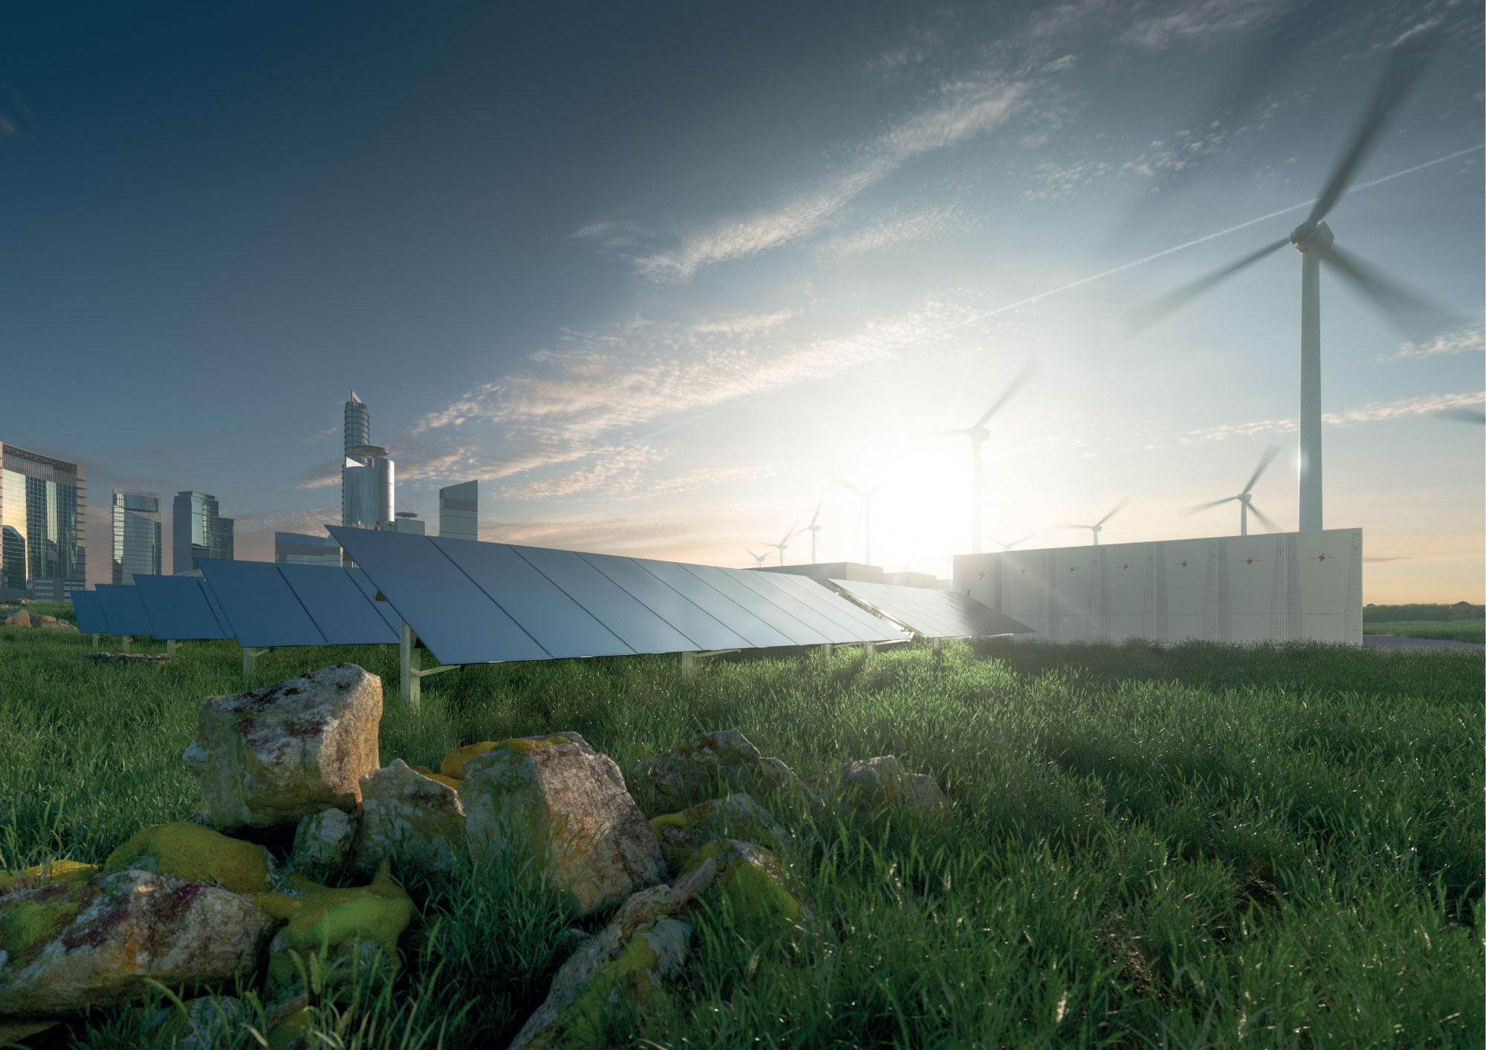
LONG-TERM POWER

Slide 17
Power how you need it, how you need it, when you need it

